Slide 1
Datathon Sensitive Data
Santosh Ilamparuthi, Data Steward, TU Delft
Marlon Domingus, DPO, EUR
May 30, 31, 2023

Slide 2
Itinerary
14:00 Sensitive data Basics Part 1 - Intro GDPR for RDM (45 min)
14:45 Break for 15 min
15:00 Sensitive data Basics Part 2 - Intro GDPR for RDM (90 min)
16:30 Break for 15 min
16:45 Hands on! Look at research projects, Asses the risks, what are good measures, How do you know when it’s enough, Classify your data (45 min)
17:30 Wrap-up (15 min)
18:00 Drinks
May 30 2023

Slide 3
Itinerary
Sensitive Data, Health Data
Data Minimisation and Pseudonymisation
Risk assessment and Mitigating Measures / DPIA, DTIA
Partnering and Collaboration
Retention Periods / FAIR data / Archiving legislation
Transparency and Consent Forms
Privacy and Ethics
Privacy By Design
Synthetic Data
May 30 2023

Slide 4
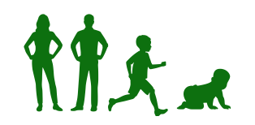
Sensitive Data
"Special Categories of Personal Data
(Sensitive Data)" (GDPR, Article 9): Data revealing racial or ethnic origin, political opinions, religious or philosophical beliefs, or trade union membership, the processing of genetic data, biometric data for the purpose of uniquely identifying a natural person, data concerning health or data concerning a natural person's sex life or sexual orientation.
May 30 2023

Slide 5
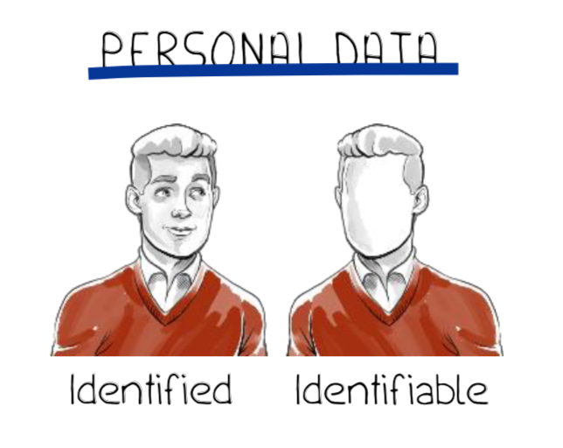
Personal Data
"Personal Data" (GDPR*, Article 4): Any information relating to an identified or identifiable natural person:
a name, an identification number, location data, an online identifier, one or more factors specific to the physical, physiological, genetic, mental, economic, cultural or social identity of that natural person.
May 30 2023

Slide 6
Identifyable
Identified: A natural person that can be uniquely singled out from other persons.
Identifiable: Not yet identified, but possible without unreasonable effort
Directly identifiable data: Unique, highly distinctive data (name, address, date of birth)
Indirectly identifiable data: Can identify a natural person by itself or if combined with other data (quasi-identifiers)
May 30 2023

Slide 7
Health Data
All data pertaining to the health status of a data subject which reveal information relating to the past, current or future physical or mental health status of the data subject. This includes information about the natural person collected in the course of the registration for, or the provision of, health care services as referred to in Directive 2011/24/EU of the European Parliament and of the Council to that natural person; a number, symbol or particular assigned to a natural person to uniquely identify the natural person for health purposes; information derived from the testing or examination of a body part or bodily substance, including from genetic data and biological samples; and any information on, for example, a disease, disability, disease risk, medical history, clinical treatment or the physiological or biomedical state of the data subject independent of its source, for example from a physician or other health professional, a hospital, a medical device or an in vitro diagnostic test. (Recital 35 GDPR)
Data concerning health: personal data related to the physical or mental health of a natural person, including the provision of health care services, which reveal information about his or her health status. (Article 4(15) GDPR)
May 30 2023

Slide 8
Examples
Mental well-being
Medical imaging
Genetic information
Health monitoring
Health data
Diagnoses
Dental records
Vaccination record
Medication

Slide 9
Health Data
Membership of patient organisation
Allergies and diet (followed because of health reasons)
Smoking, drinking and drug habits
“Lifestyle and well-being data will, in general, be considered health data, when they are processed in a medical context […] or where information regarding an individual’s health may reasonably be inferred from the data (in itself, or combined with other information), especially when the purpose […] is to monitor the health or well-being of the individual (whether in a medical context or otherwise).”
Source: EDPS, Opinion 1/2015 Mobile Health Reconciling technological innovation with data protection, 2015
May 30 2023

Slide 10
Medical Data
“Health data normally includes:
medical data (e.g. doctor referrals and prescriptions, medical examination reports, laboratory tests, radiographs, etc.), as well as
administrative and financial data relating to health (e.g. documents concerning hospital admissions, social security number, medical appointments scheduling, invoices for healthcare service provision, etc.)”
Source: Opinion of the European Data Protection Supervisor on the proposal for a directive of the European Parliament and of the Council on the application of patients’ rights in cross-border healthcare, 2009
May 30 2023

Slide 11
Medical Data
KNMG: (Royal Dutch Medical Association) “Information that, directly or indirectly, concerns the health or physical and/or mental condition of an identifiable patient and data relating to a patient that is registered in a record maintained by a doctor.” Source: KNMG-guideline ‘Handling medical data’, 2020
Health data
Medical data
May 30 2023

Slide 12
Sources of health data in research
Patient (via surveys, interviews, apps, etc.)
Care provider (hospitals, physicians, physical therapists, etc.)
(Most Common) Sources of Health Data
Knowledge/research institutes (IKNL, Nivel, PALGA, SFK, etc.)
Governmental organisations (Zorginstituut, CBS, RIVM, etc.)
Health care insurers
Corporations

Slide 13
Data Minimisation and Pseudonymisation
EU GDPR Article 5: "Principles relating to processing of personal data"
(c) adequate, relevant and limited to what is necessary in relation to the purposes for which they are processed ('data minimisation’)
EU GDPR Article 25: ”Data protection by design and by default"
1. Taking into account the state of the art, the cost of implementation and the nature, scope, context and purposes of processing as well as the risks of varying likelihood and severity for rights and freedoms of natural persons posed by the processing, the controller shall, both at the time of the determination of the means for processing and at the time of the processing itself, implement appropriate technical and organisational measures, such as pseudonymisation, which are designed to implement data-protection principles, such as data minimisation, in an effective manner and to integrate the necessary safeguards into the processing in order to meet the requirements of this Regulation and protect the rights of data subjects.
May 30 2023

Slide 14
Data Protection;
Fundamental Right
Principles
Accountability
Charter of Fundamental Rights
of the European Union Art. 8.
GDPR Art. 5.1.Principles relating to processing of personal data
Lawfulness,
Fairness,
Transparency
GDPR Art. 5.2. Accountability Principles relating to processing of personal data
Article 8 Protection of personal data
1. Everyone has the right to the protection of personal data concerning him or her. 2. Such data must be processed fairly for specified purposes and on the basis of the consent of the person concerned or some other legitimate basis laid down by law. Everyone has the right of access to data which has been collected concerning him or her, and the right to have it rectified. 3. Compliance with these rules shall be subject to control by an independent authority.
Integrity,
Confidentiality
Purpose Limitation
Storage Limitation
Data Minimisation
Accuracy
Marlon Domingus, Erasmus University Rotterdam
marlon.domingus@eur.nl September 2020

Slide 15
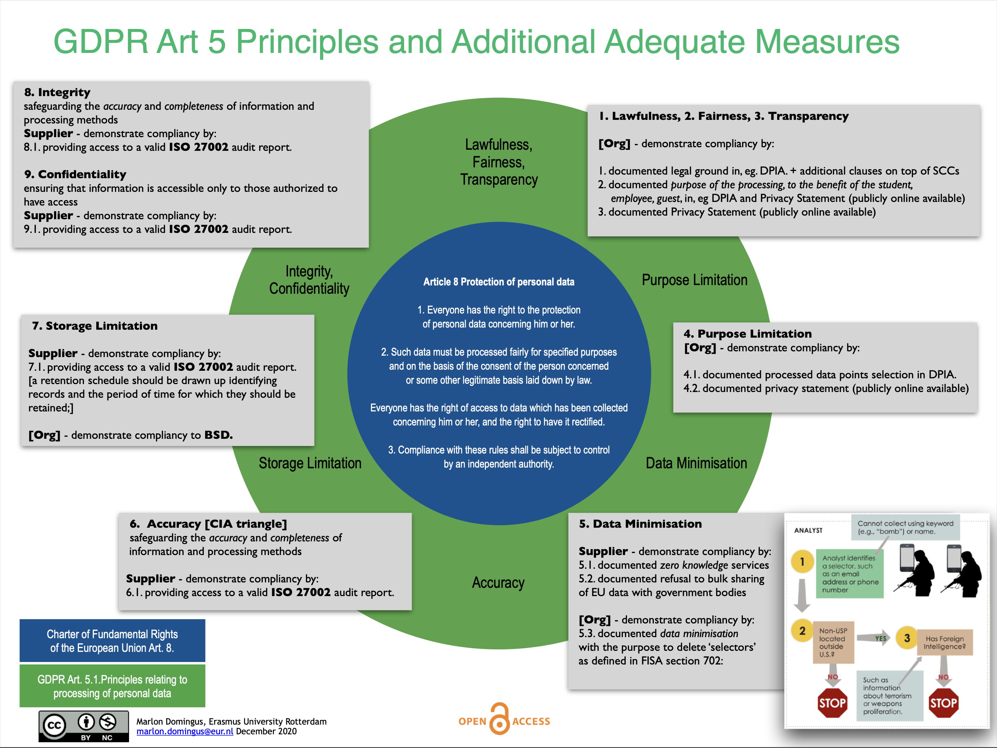

Slide 16
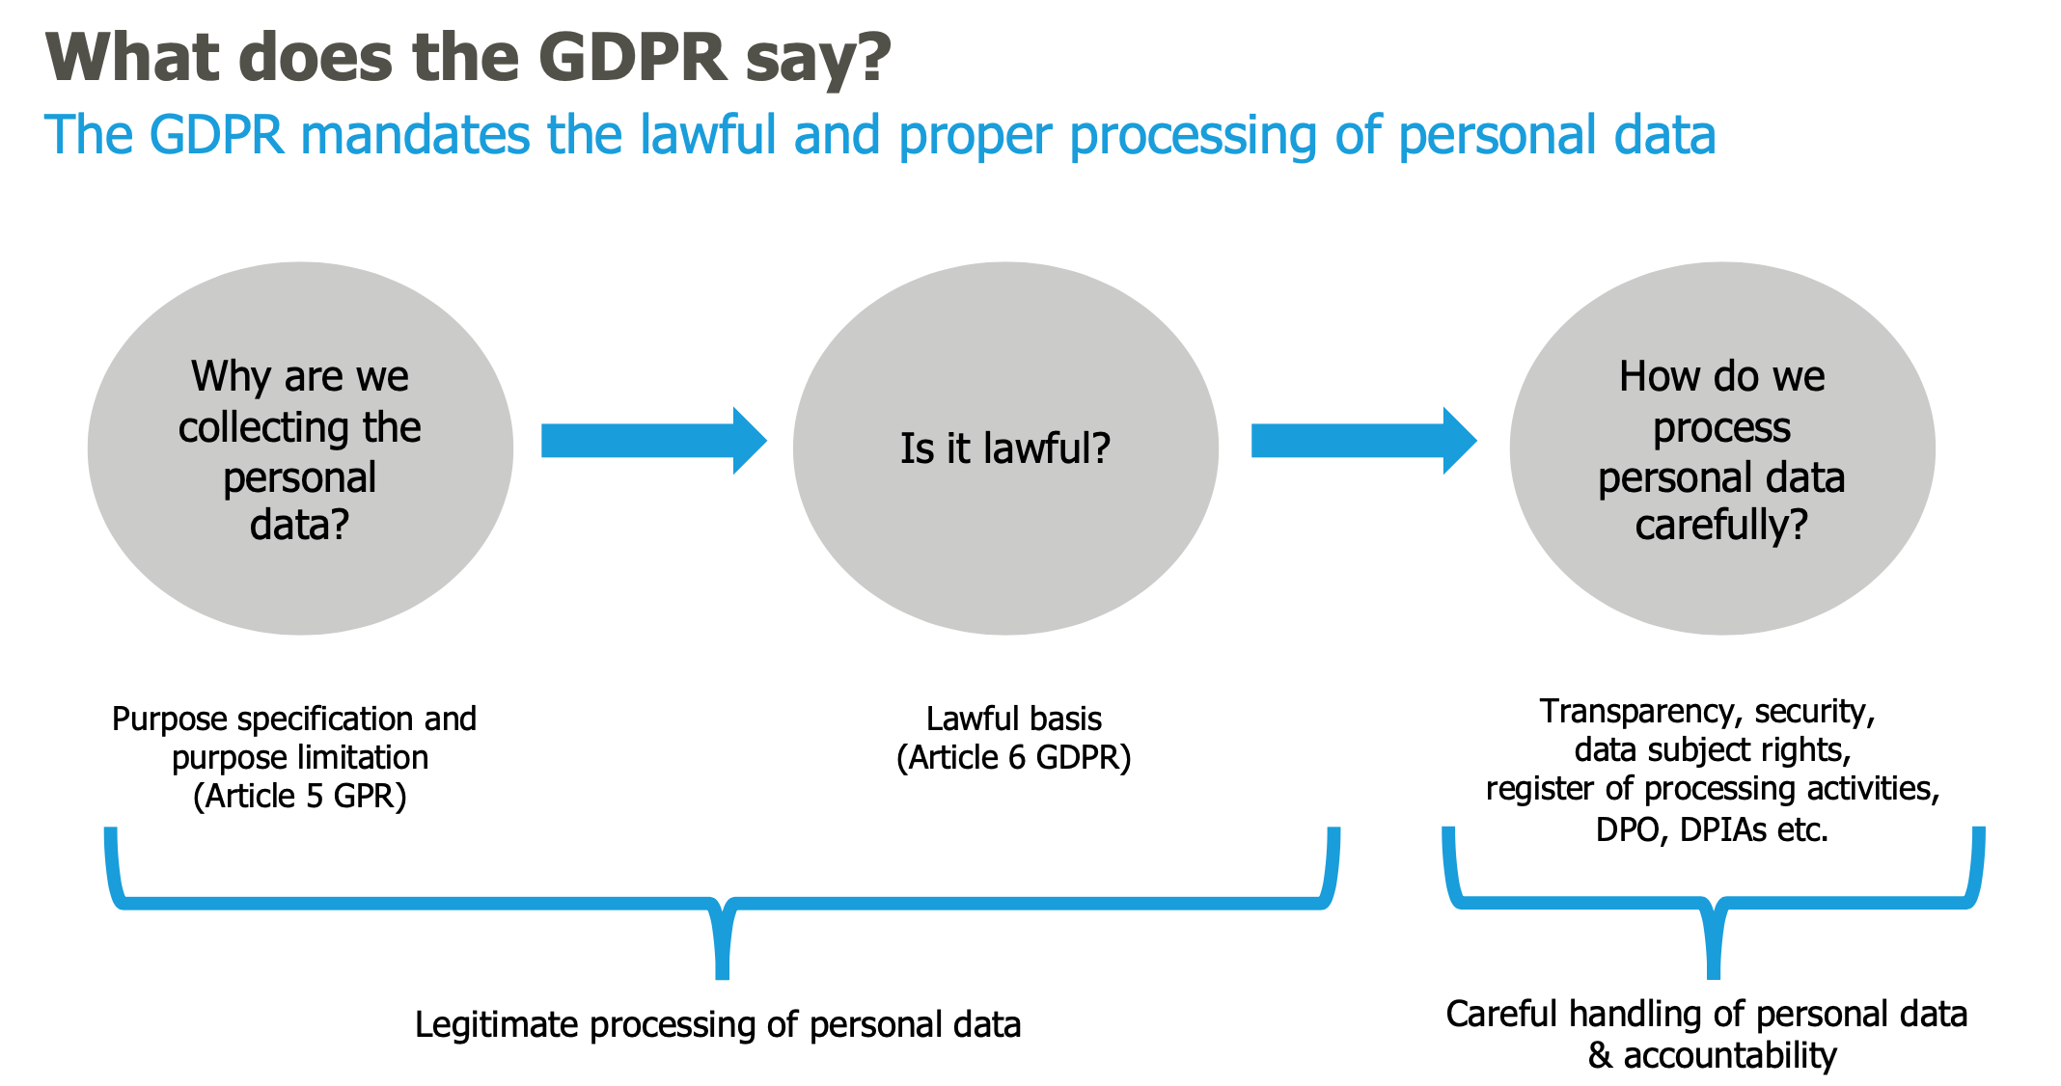
Lawful and proper processing
Bron: Mr. dr. Bart W. Schermer, Considerati. 2019.

Slide 17
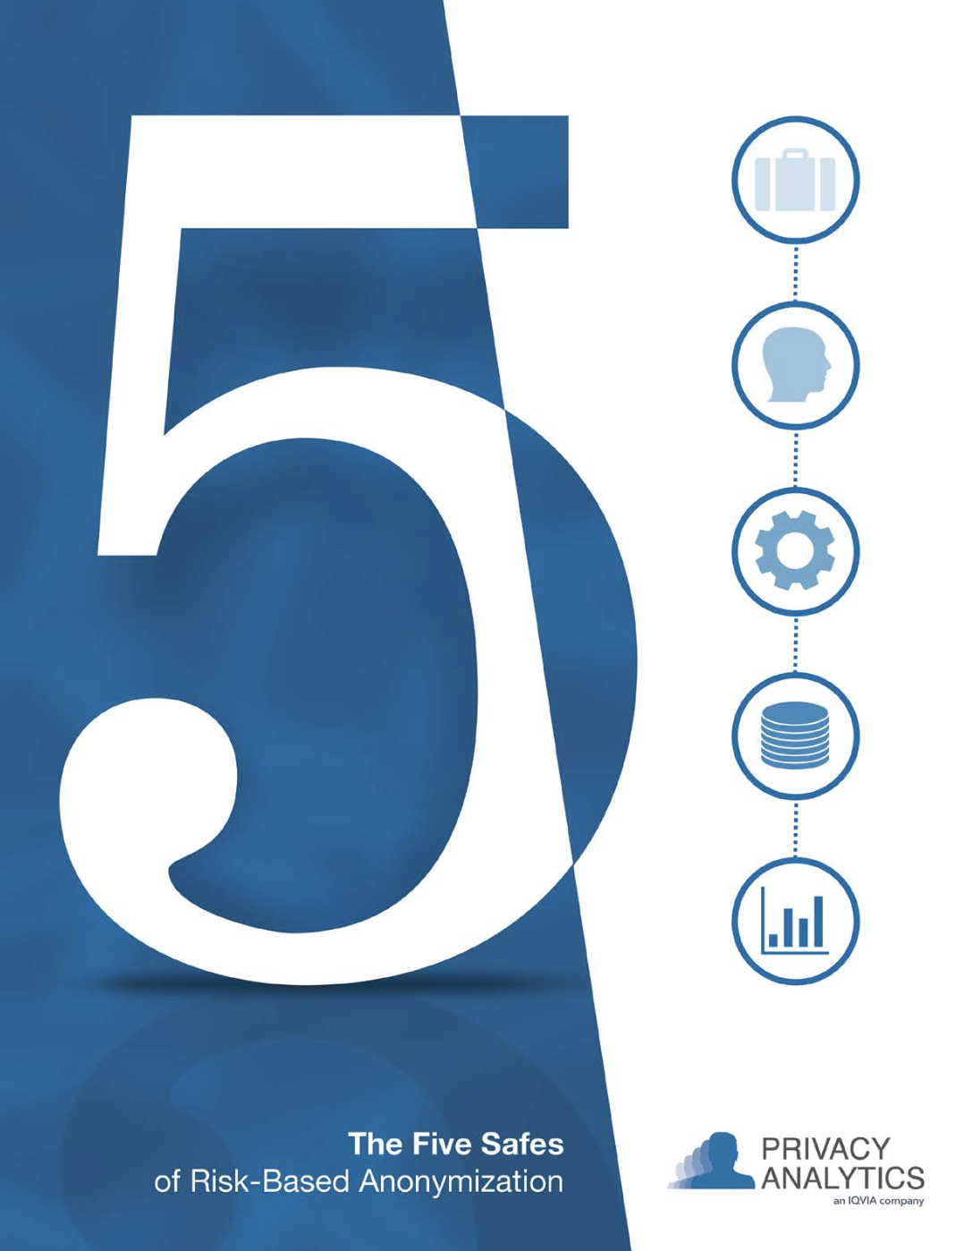
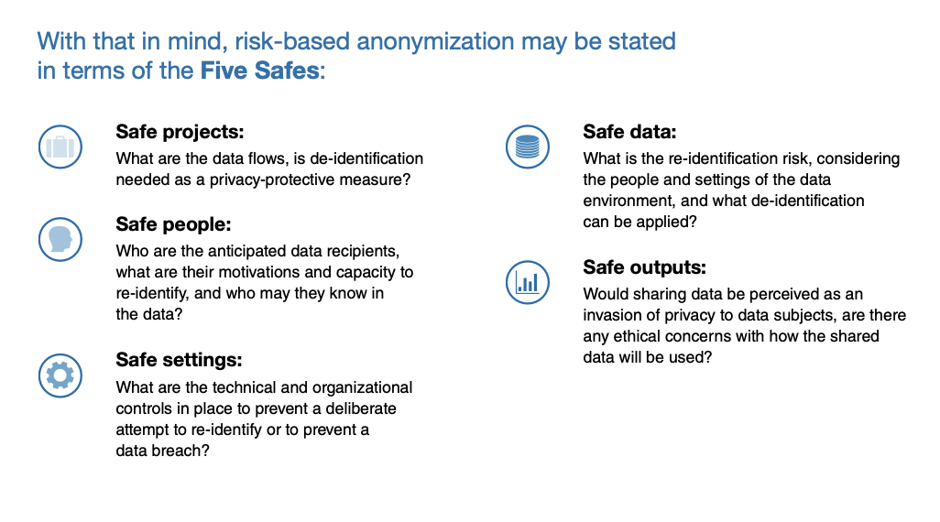
Data Minimisation and Pseudonymisation
May 30 2023

Slide 18
Data Minimisation and Pseudonymisation
May 30 2023

Slide 19
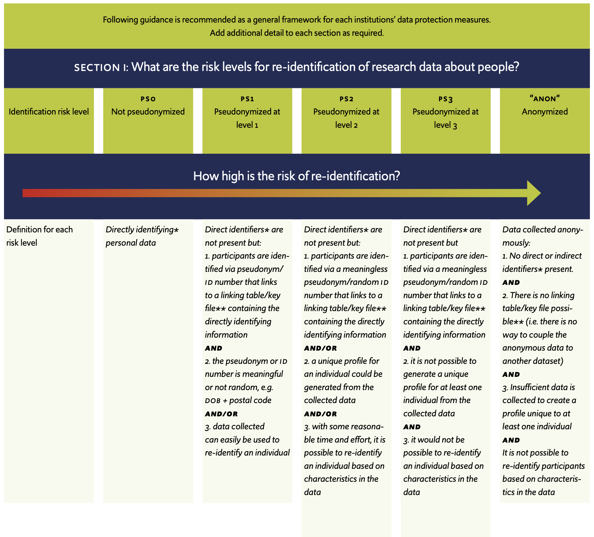
May 30 2023

Slide 20
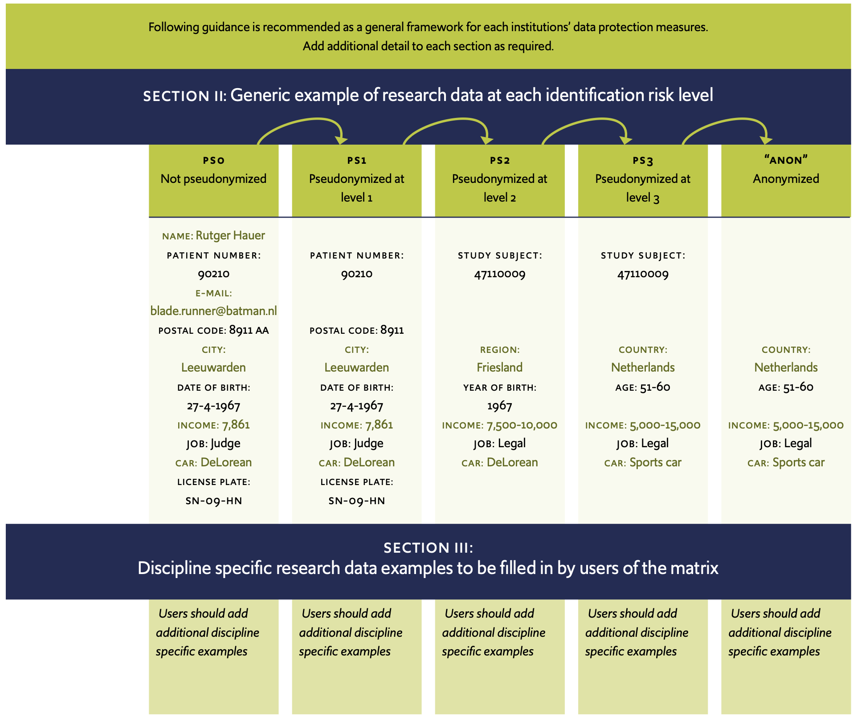
May 30 2023

Slide 21
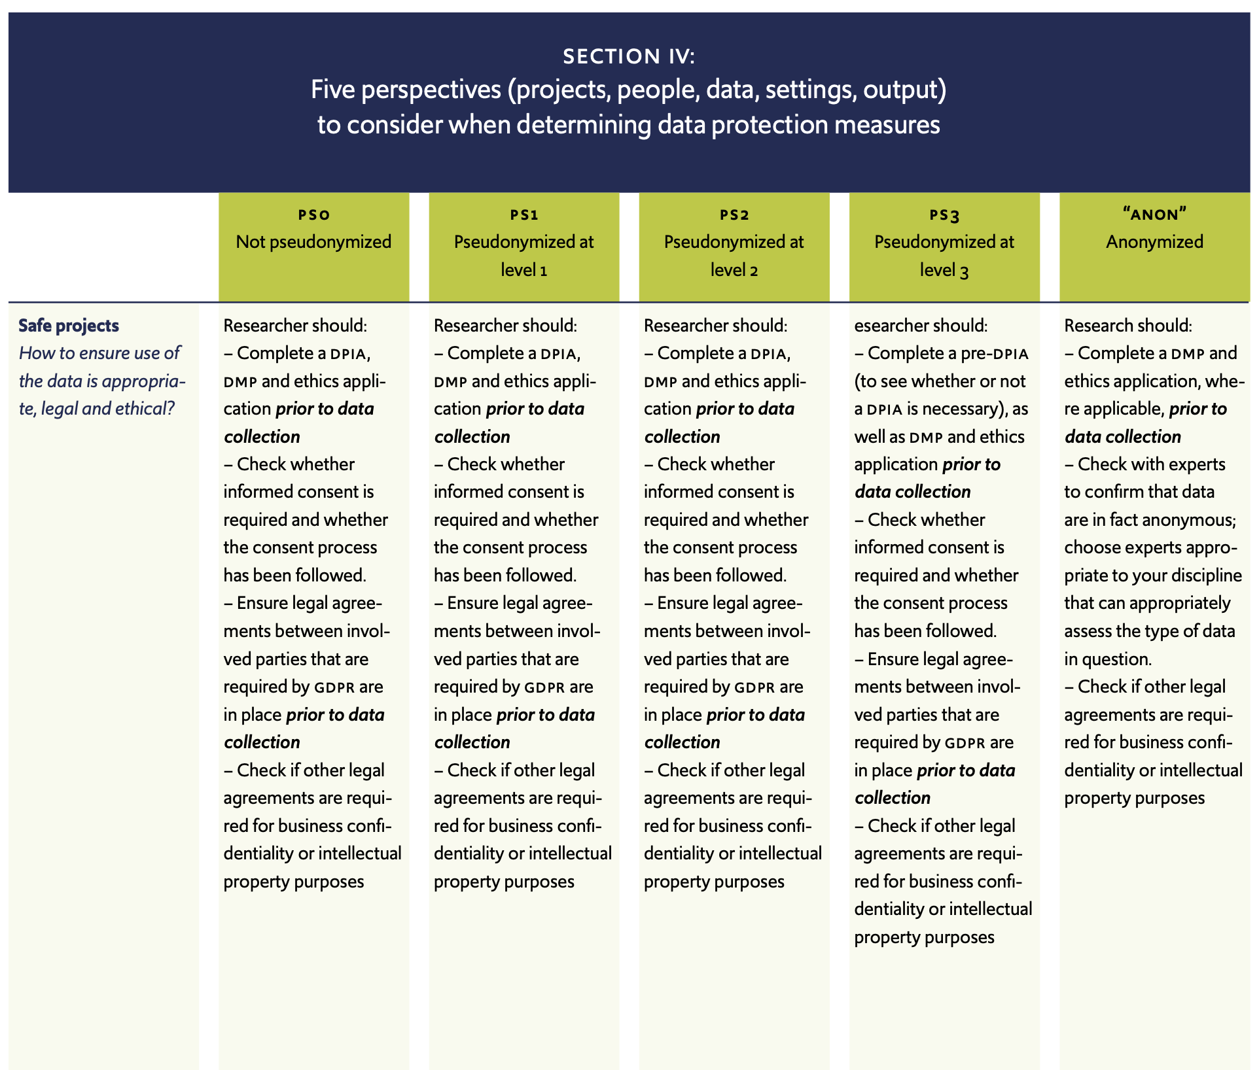
May 30 2023

Slide 22
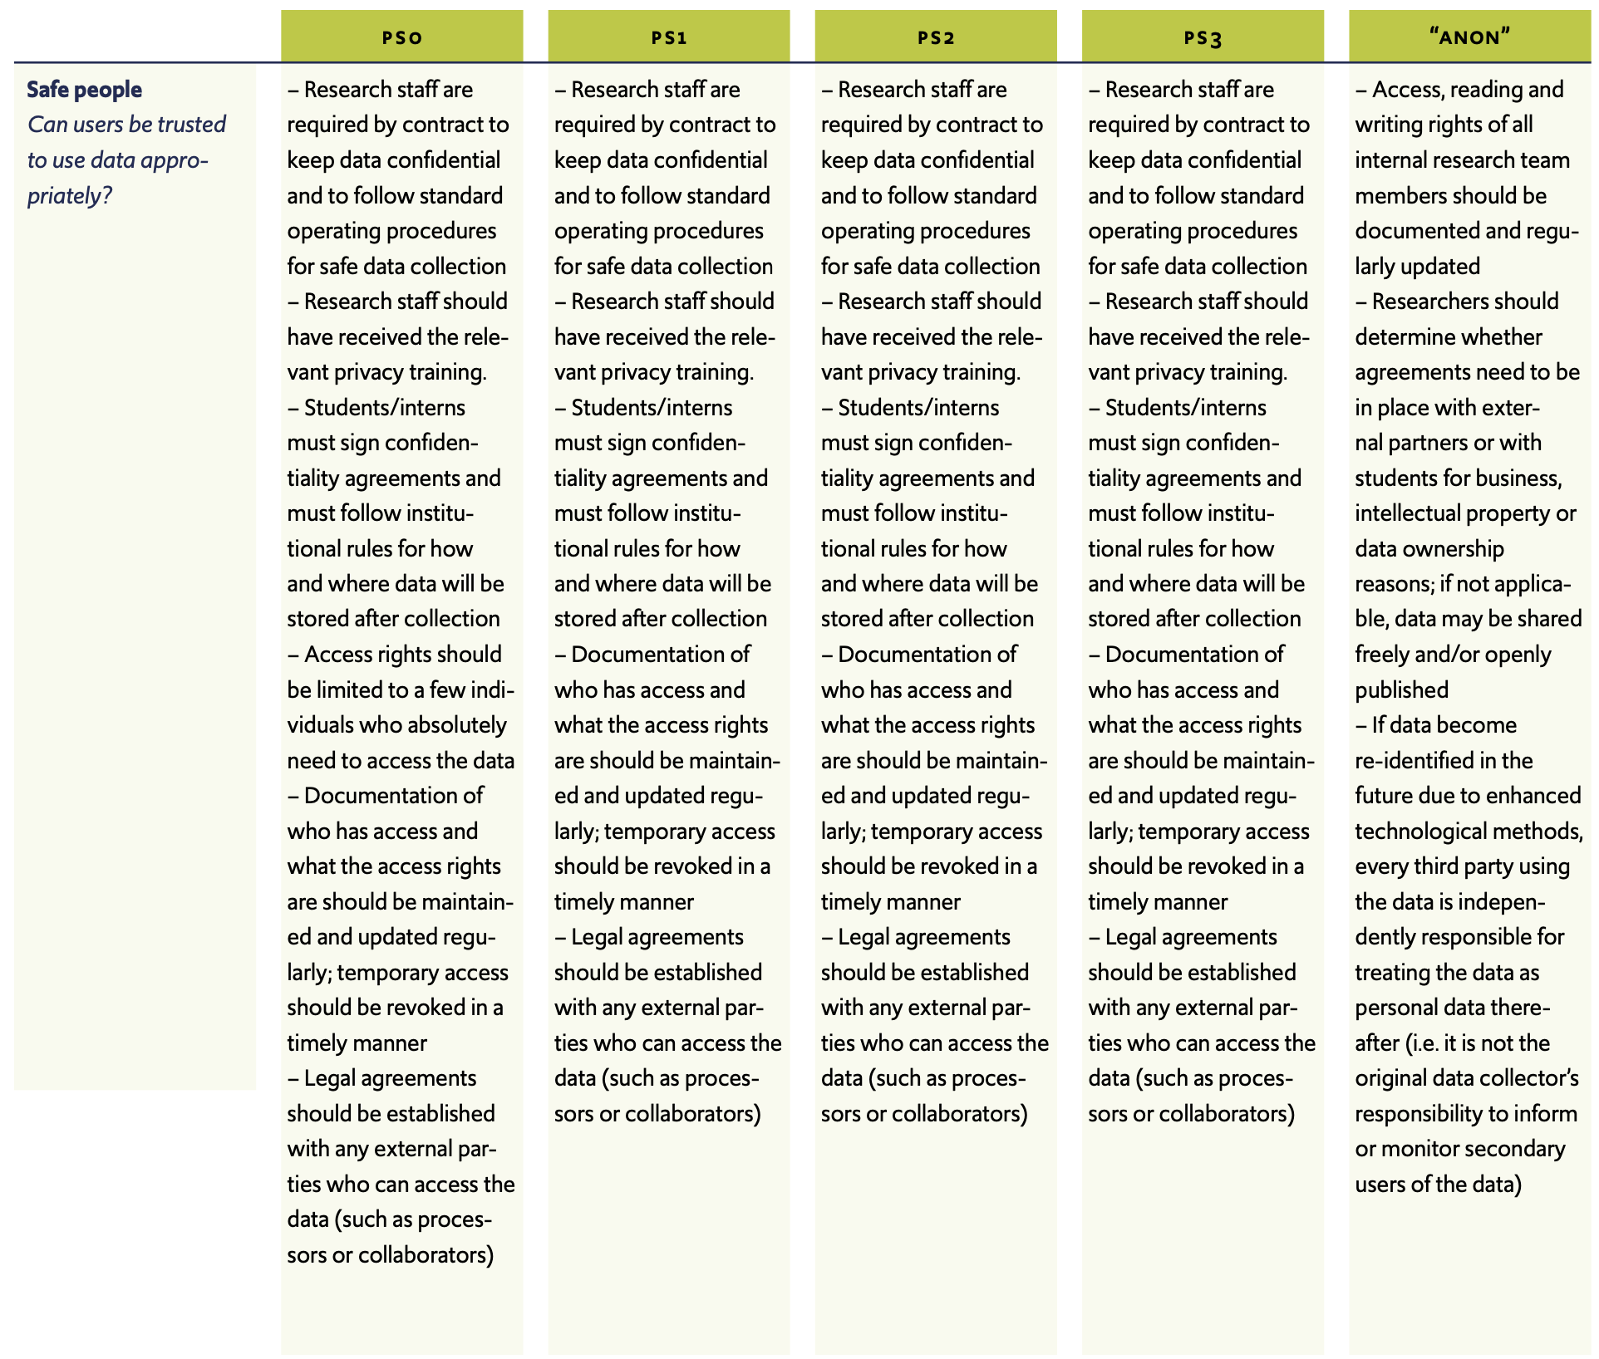
May 30 2023

Slide 23
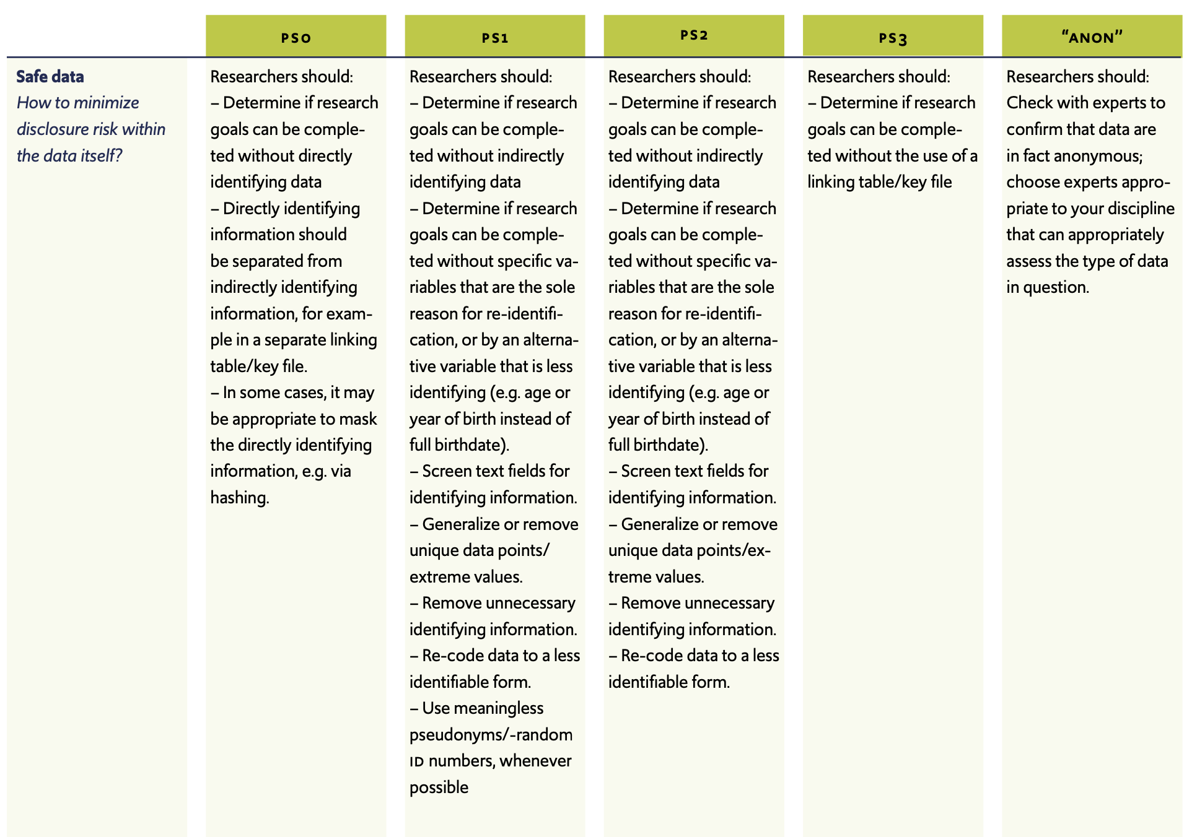
May 30 2023

Slide 24
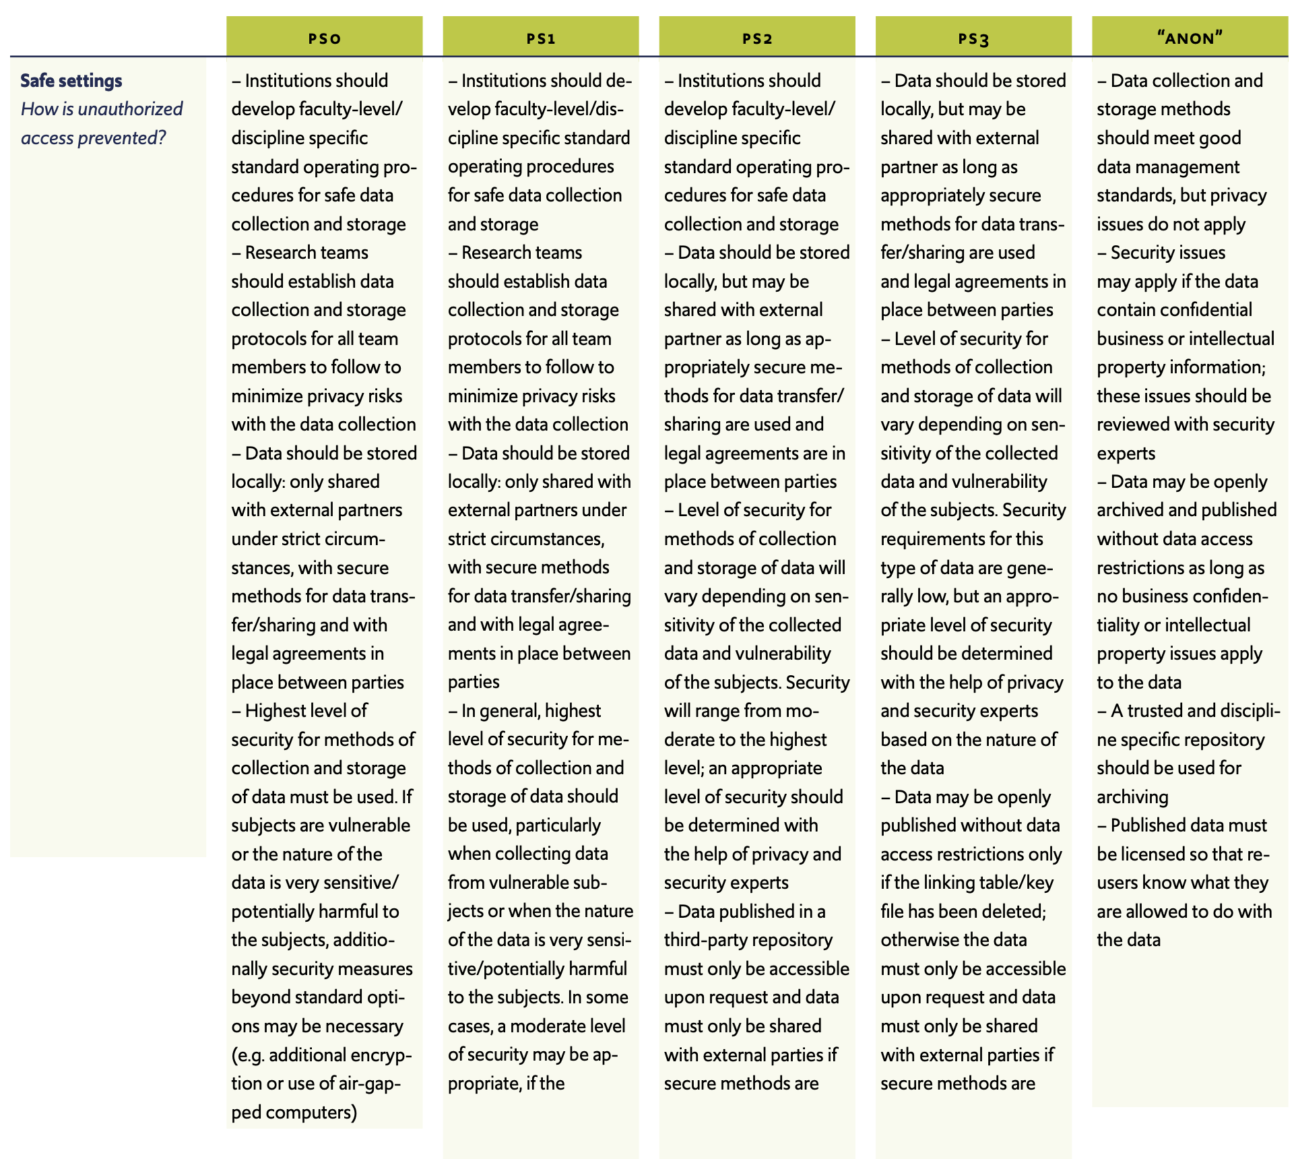
May 30 2023

Slide 25
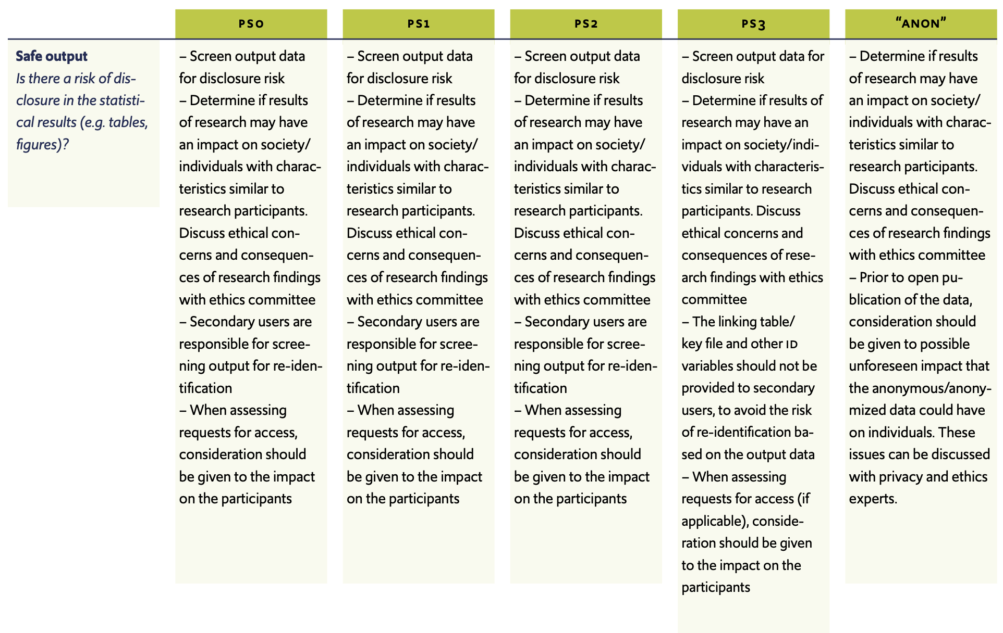
May 30 2023

Slide 26
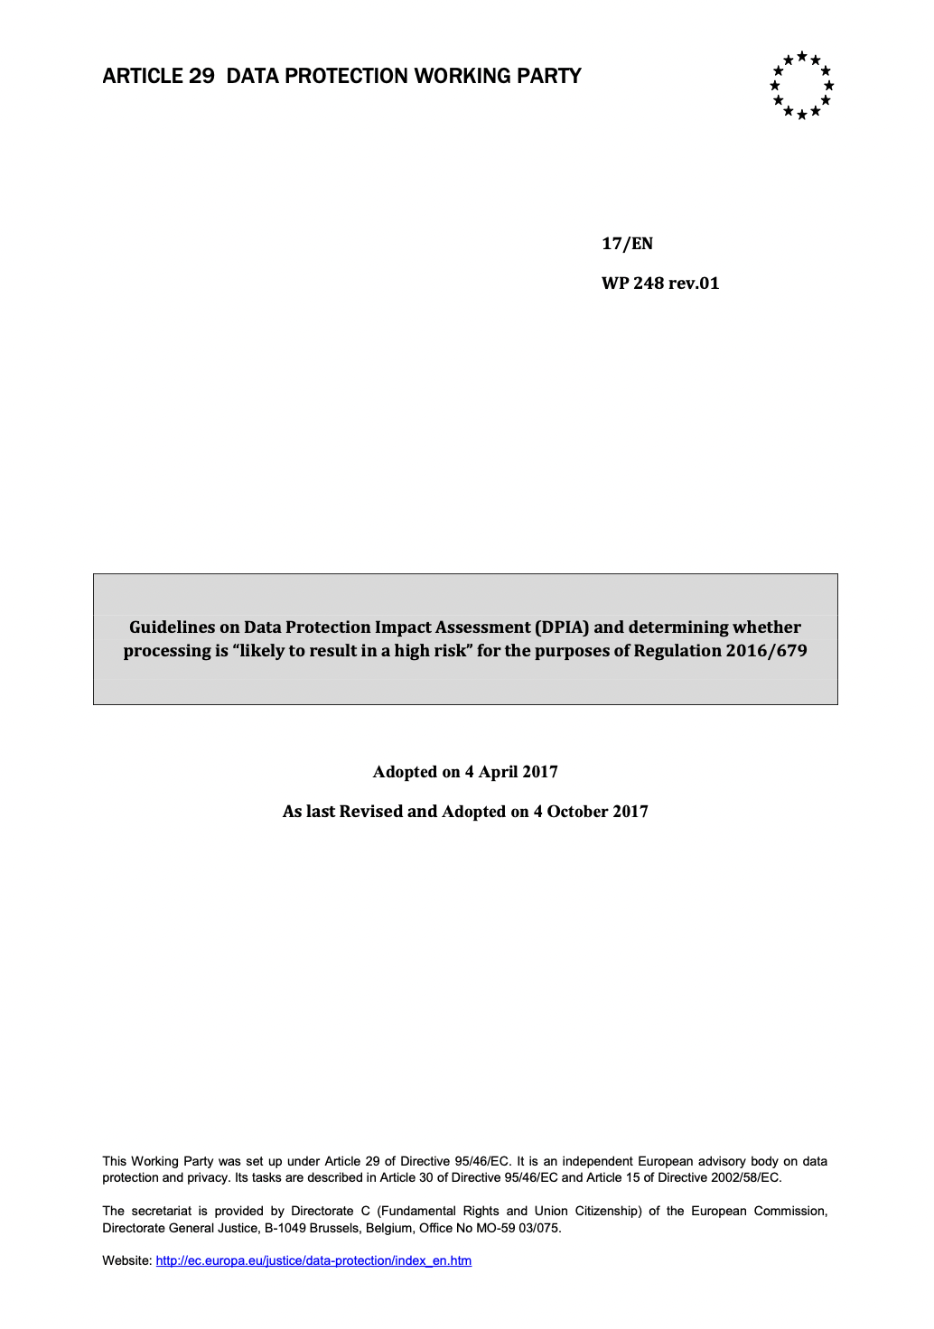
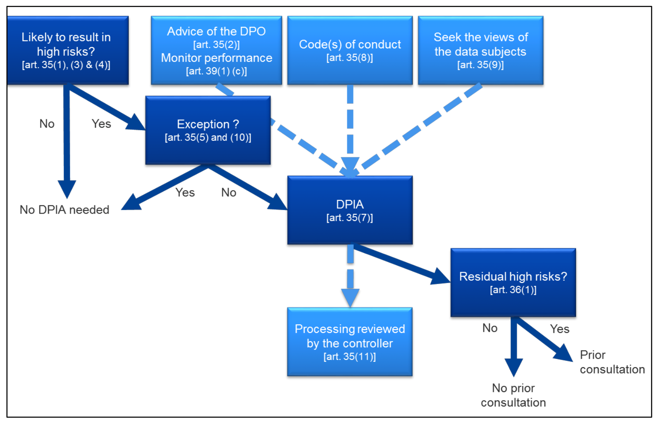
Risk assessment and Mitigating Measures
DPIA, DTIA
May 30 2023

Slide 27
High Risk Processing:
Data Protection Impact Assessment (DPIA)
1. Evaluation or scoring, including profiling and predicting, especially from “aspects concerning the data subject's performance at work, economic situation, health, personal preferences or interests, reliability or behavior, location or movements” (recitals 71 and 91). Examples of this could include a financial institution that screens its customers against a credit reference database or against an anti-money laundering and counter-terrorist financing (AML/CTF) or fraud database, or a biotechnology company offering genetic tests directly to consumers in order to assess and predict the disease/health risks, or a company building behavioural or marketing profiles based on usage or navigation on its website.
2. Automated-decision making with legal or similar significant effect: processing that aims at taking decisions on data subjects producing “legal effects concerning the natural person” or which “similarly significantly affects the natural person” (Article 35(3)(a)). For example, the processing may lead to the exclusion or discrimination against individuals. Processing with little or no effect on individuals does not match this specific criterion. Further explanations on these notions will be provided in the upcoming WP29 Guidelines on Profiling.
3. Systematic monitoring: processing used to observe, monitor or control data subjects, including data collected through networks or “a systematic monitoring of a publicly accessible area” (Article 35(3)(c))15. This type of monitoring is a criterion because the personal data may be collected in circumstances where data subjects may not be aware of who is collecting their data and how they will be used. Additionally, it may be impossible for individuals to avoid being subject to such processing in public (or publicly accessible) space(s).
Source: https://ec.europa.eu/newsroom/article29/items/611236

Slide 28
High Risk Processing:
Data Protection Impact Assessment (DPIA)
4. Sensitive data or data of a highly personal nature: this includes special categories of personal data as defined in Article 9 (for example information about individuals’ political opinions), as well as personal data relating to criminal convictions or offences as defined in Article 10. An example would be a general hospital keeping patients’ medical records or a private investigator keeping offenders’ details. Beyond these provisions of the GDPR, some categories of data can be considered as increasing the possible risk to the rights and freedoms of individuals. These personal data are considered as sensitive (as this term is commonly understood) because they are linked to household and private activities (such as electronic communications whose confidentiality should be protected), or because they impact the exercise of a fundamental right (such as location data whose collection questions the freedom of movement) or because their violation clearly involves serious impacts in the data subject’s daily life (such as financial data that might be used for payment fraud). In this regard, whether the data has already been made publicly available by the data subject or by third parties may be relevant. The fact that personal data is publicly available may be considered as a factor in the assessment if the data was expected to be further used for certain purposes. This criterion may also include data such as personal documents, emails, diaries, notes from e-readers equipped with note-taking features, and very personal information contained in life-logging applications.
Source: https://ec.europa.eu/newsroom/article29/items/611236

Slide 29
High Risk Processing:
Data Protection Impact Assessment (DPIA)
5. Data processed on a large scale: the GDPR does not define what constitutes large-scale, though recital 91 provides some guidance. In any event, the WP29 recommends that the following factors, in particular, be considered when determining whether the processing is carried out on a large scale:
the number of data subjects concerned, either as a specific number or as a proportion of the relevant population;
the volume of data and/or the range of different data items being processed;
the duration, or permanence, of the data processing activity;
the geographical extent of the processing activity.
6. Matching or combining datasets, for example originating from two or more data processing operations performed for different purposes and/or by different data controllers in a way that would exceed the reasonable expectations of the data subject17.
7. Data concerning vulnerable data subjects (recital 75): the processing of this type of data is a criterion because of the increased power imbalance between the data subjects and the data controller, meaning the individuals may be unable to easily consent to, or oppose, the processing of their data, or exercise their rights. Vulnerable data subjects may include children (they can be considered as not able to knowingly and thoughtfully oppose or consent to the processing of their data), employees , more vulnerable segments of the population requiring special protection (mentally ill persons, asylum seekers, or the elderly, patients, etc.), and in any case where an imbalance in the relationship between the position of the data subject and the controller can be identified.
Source: https://ec.europa.eu/newsroom/article29/items/611236

Slide 30
High Risk Processing:
Data Protection Impact Assessment (DPIA)
8. Innovative use or applying new technological or organisational solutions, like combining use of finger print and face recognition for improved physical access control, etc. The GDPR makes it clear (Article 35(1) and recitals 89 and 91) that the use of a new technology, defined in “accordance with the achieved state of technological knowledge” (recital 91), can trigger the need to carry out a DPIA. This is because the use of such technology can involve novel forms of data collection and usage, possibly with a high risk to individuals’ rights and freedoms. Indeed, the personal and social consequences of the deployment of a new technology may be unknown. A DPIA will help the data controller to understand and to treat such risks. For example, certain “Internet of Things” applications could have a significant impact on individuals’ daily lives and privacy; and therefore require a DPIA.
9. When the processing in itself “prevents data subjects from exercising a right or using a service or a contract” (Article 22 and recital 91). This includes processing operations that aims at allowing, modifying or refusing data subjects’ access to a service or entry into a contract. An example of this is where a bank screens its customers against a credit reference database in order to decide whether to offer them a loan.
Source: https://ec.europa.eu/newsroom/article29/items/611236

Slide 31
Privacy in Context - Operationalizing The Risk Based Approach
Data Processing in Academia
masking and / or
de-identification
data collection
personal data
storage
analysis
deletion
anonymization
publication
archiving
1. Categorizing Risk 2. Prioritizing Risk 3. Risk Assessment: Likelihood & Impact 4. Selection of Controls 5. Evaluation
Action:
Short Term
Medium Term
Do Nothing
Risks related to:
Data Subjects
Data Processing & Data Transfer
Tooling & Platforms Used
Third Parties and Subcontrollers
Controller’s Reputation
Society & Environment
Organizational
Technical
Legal
Design
Training
Risk:
Fully Mitigated
Unchanged Risk
Residual Risk
Strategic Risk
External Risk
Operational Risk
Erasmus University Rotterdam
marlon.domingus@eur.nl
January 2022

Slide 32
Privacy in Context - Operationalizing The Risk Based Approach
Data Processing in Academia
masking and / or
de-identification
data collection
personal data
storage
analysis
deletion
anonymization
publication
archiving
1. Categorizing Risk 2. Prioritizing Risk 3. Risk Assessment: Likelihood & Impact 4. Selection of Controls 5. Evaluation
Action:
Short Term
Medium Term
Do Nothing
Risks related to:
Data Subjects
Data Processing & Data Transfer
Tooling & Platforms Used
Third Parties and Subcontrollers
Controller’s Reputation
Society & Environment
Organizational
Technical
Legal
Design
Training
Risk:
Fully Mitigated
Unchanged Risk
Residual Risk
Strategic Risk
External Risk
Operational Risk
Input:
Policy & Governance
Policy Guidelines
Policy Review Cycle
Output:
Risk Log Entry
Start Risk Management
Risk Acceptance Statement
Output:
Risk Log Entry
Policy Recommendations
Audit Recommendations
Risk Acceptance Statement
Output:
Measures
Training Content
Design Recommendations
Output:
DPIA, TIA, Security Assessment Report
Communication to Data Subjects (Transparency)
List of vulnerabilities
Input:
Standards & Norms
Legislation
Ethics & Values
Input:
Standards & Norms
Legislation
Ethics & Values
Input:
Standards & Norms
Legislation
Ethics & Values
Input:
Standards & Norms
Legislation
Ethics & Values
Input:
Standards & Norms
Legislation
Ethics & Values
Erasmus University Rotterdam
marlon.domingus@eur.nl
January 2022

Slide 33
Partnering and Collaboration
Planning
Data Collection
Data structure
Store
Analyse
Publish & archive
(DPIA)
RDM
Ethical Approval
Existing data
New measurements
Pseudonymise personal data
Encrypt keyfile and store separately from research data
Store pseudonymised data in end to end encrypted collaboration platform
Provide access and edit rights to research team members with start and end date. Use safe software.
Publish data in a trusted repository
Provide access compliant to Consent Form
COLLABORATION
GEOGRAPHY
EU funded research project, also outside the EU
DATA
Public - Private
text, statistical data, databases
May 30 2023

Slide 34
Academic Research: Scales of Collaboration and
Accompanying Appropriate Privacy Enhancing Measures
Data Processing in Academic Research
data masking and / or
data de-identification
data collection
personal data
data storage
data analysis
data deletion
data publication
data archiving
Marlon Domingus, Erasmus University Rotterdam
marlon.domingus@eur.nl March 2018

Slide 35
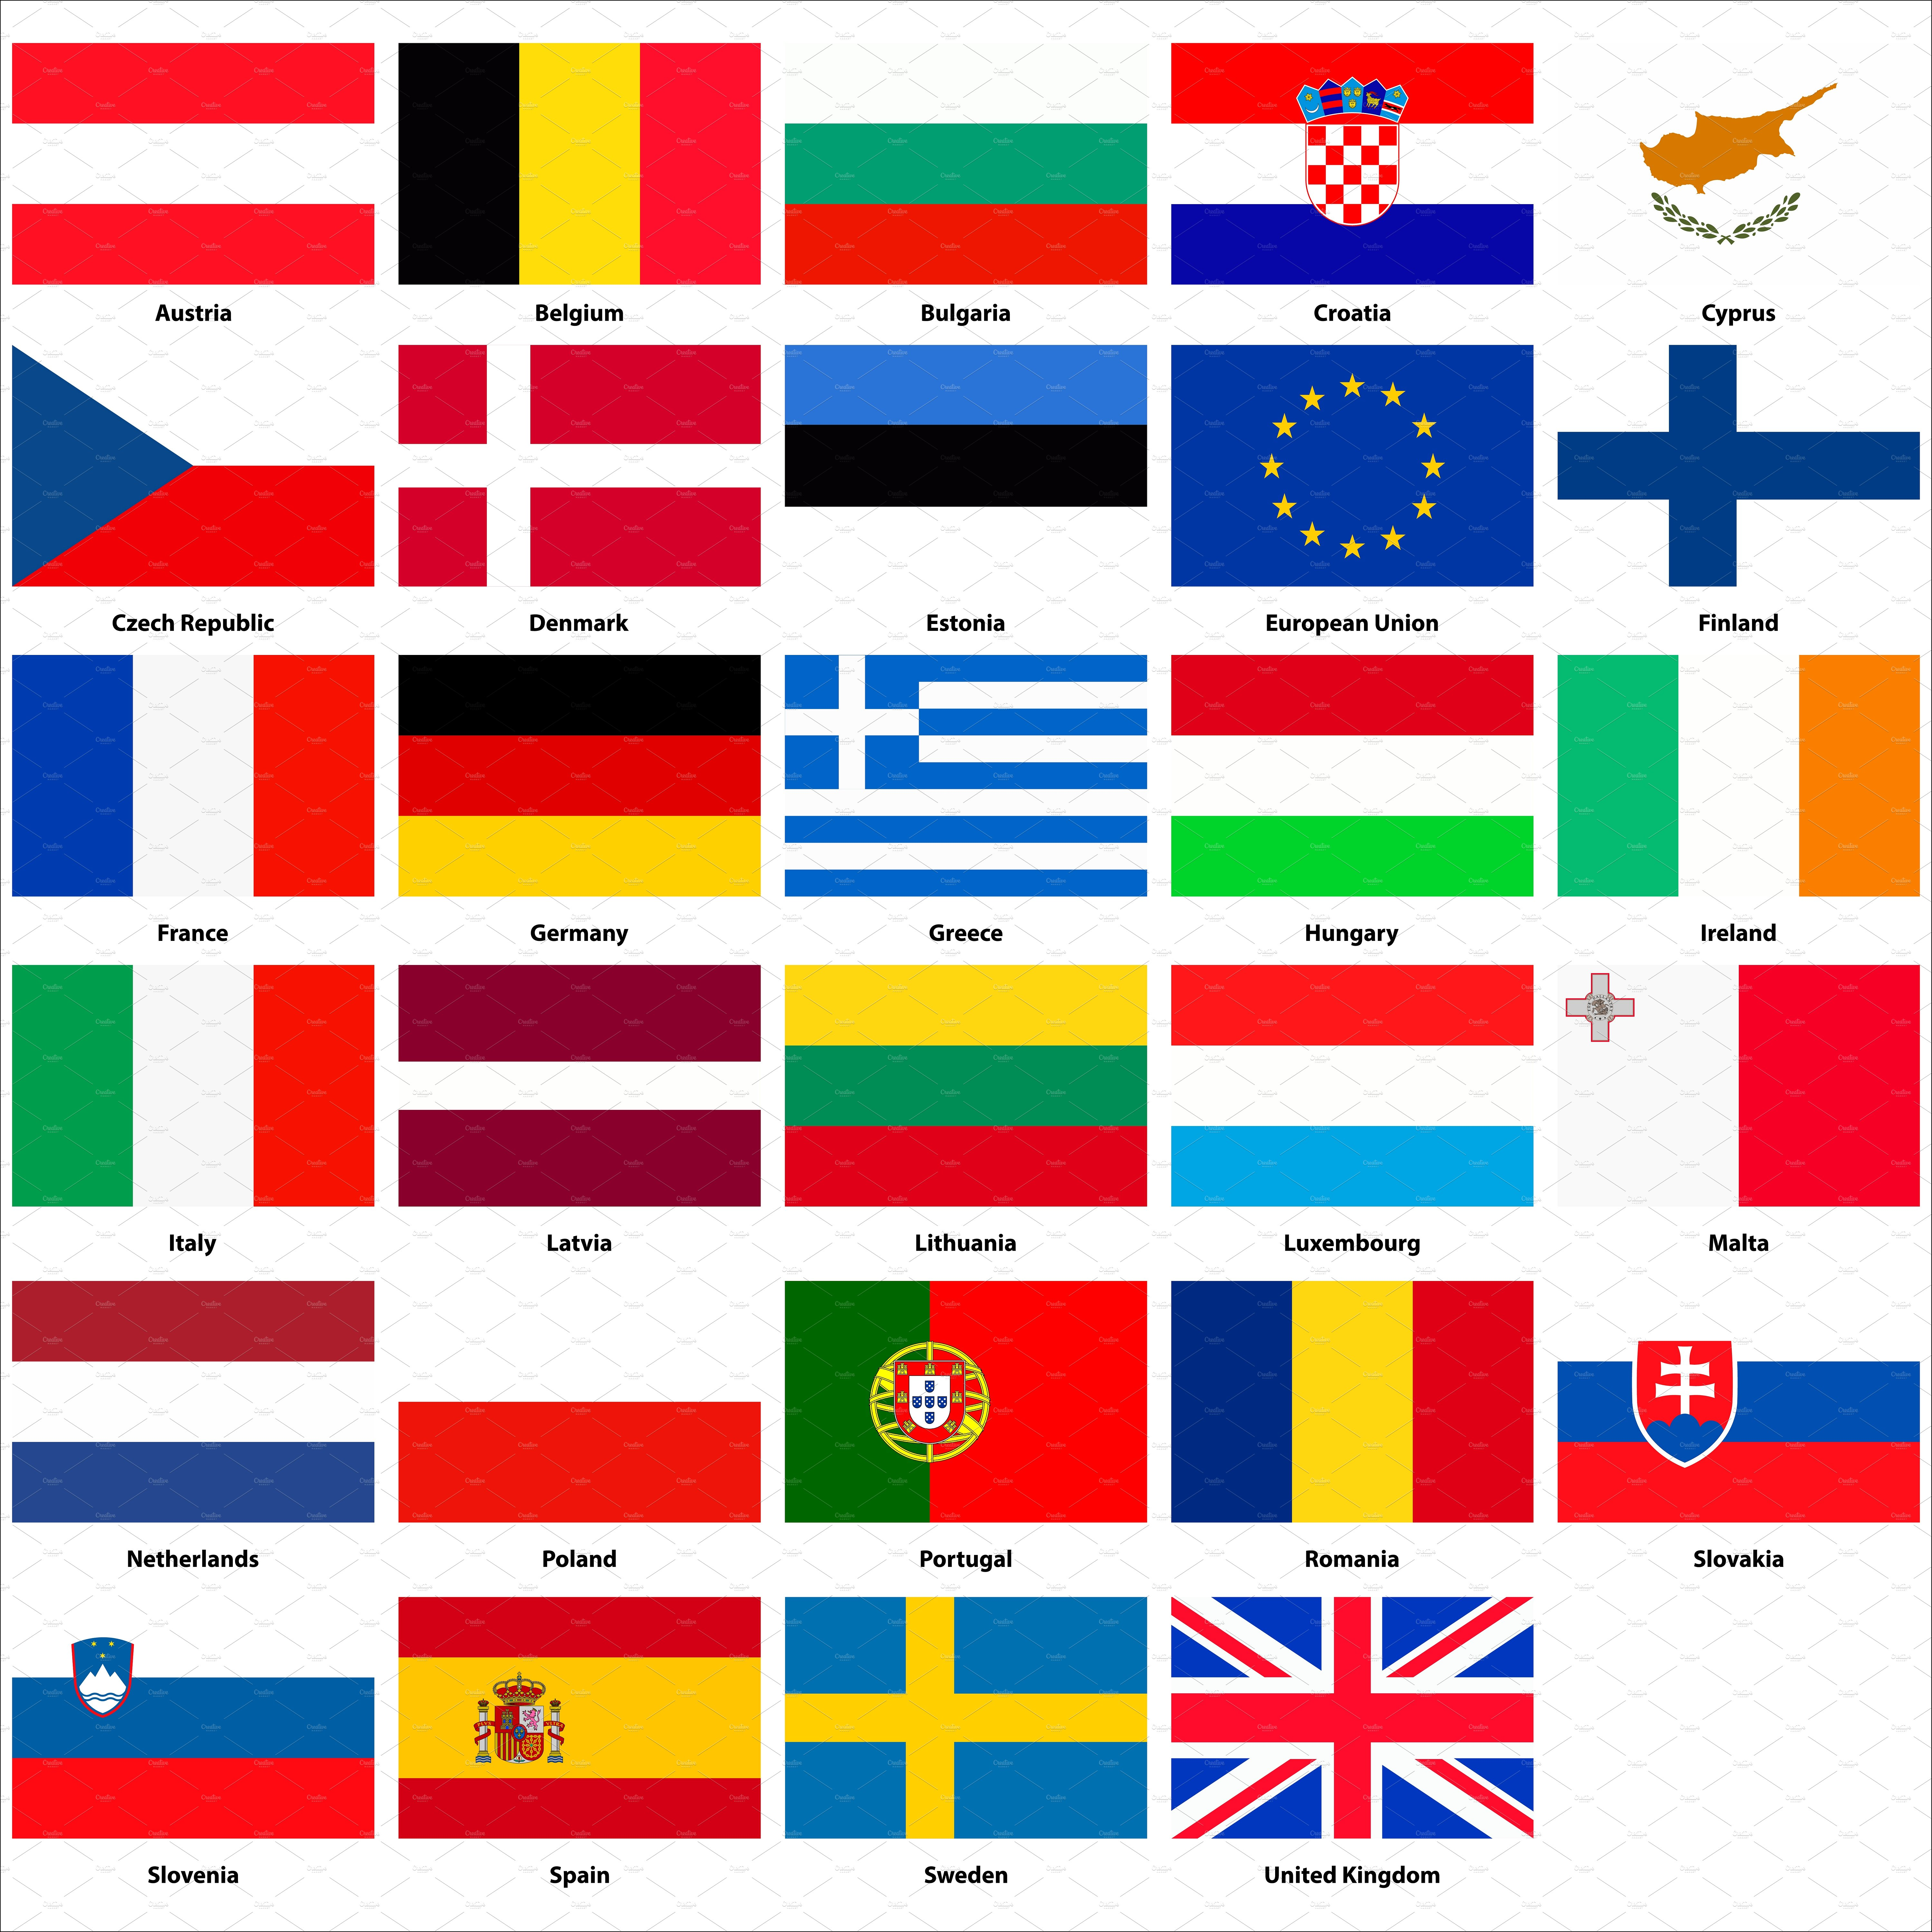
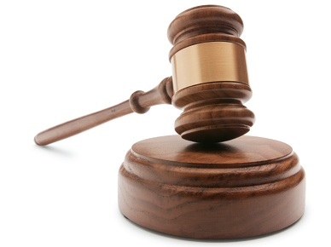
Research Scenario 1
Pan European Public-Private H2020 Funded Consortium: Big Data Health Economics
access existing data
research funding
H2020
research proposal
- public-private
research project
- international
analyse data
publish article
archive article and data
store data
research group
generate data
Marlon Domingus, June 13 2017, version 0.1

Slide 36
Retention Periods / FAIR data / Archiving legislation
European
Open Science Cloud
Proposal
Open
DOAR
Data Governance
Act Proposal
Open Data
Pilot
IPR Action Plan
Study on the Economic
and Technical Evolution
of the Scientific Publication
Markets in Europe
Digital Single
Market
Recommendation on access to
and preservation of scientific information
General Data Protection
Regulation
Innovation & Knowledge
Transfer
FAIR Principles
Open Data
Directive incl. FAIR
OpenAIRE
Knowledge
Triangle
Plan S
2005 | 2006 | 2007 | 2008 | 2009 | 2010 | 2011 | 2012 | 2013 | 2014 | 2015 | 2016 | 2017 | 2018 | 2019 | 2020
May 30 2023

Slide 37
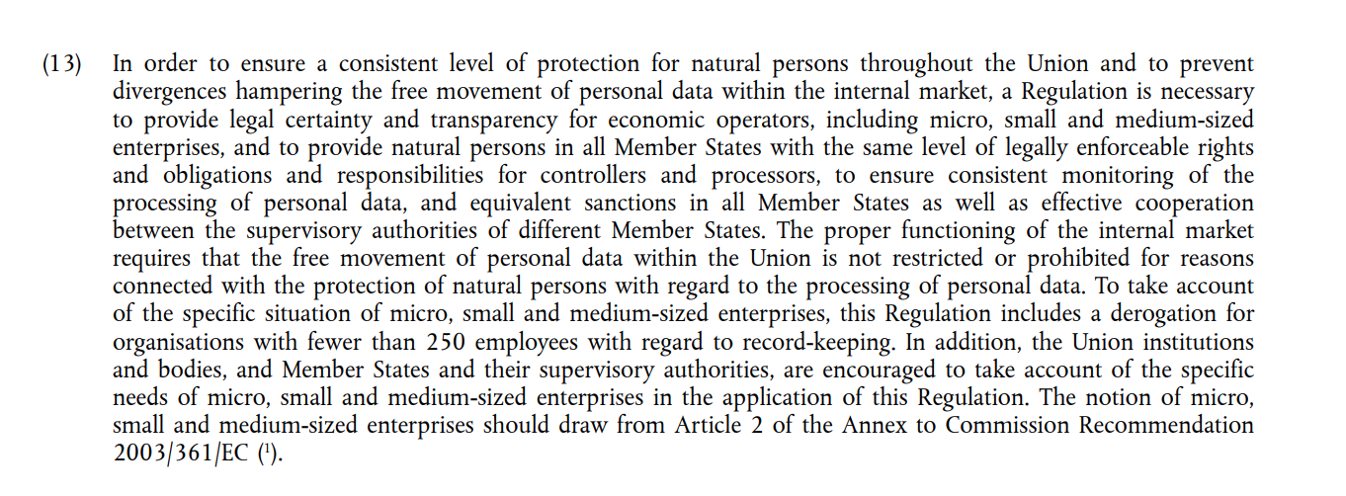
GDPR: ‘the proper functioning of the internal market, requires that the free movement of personal data within the EU is not restricted’.
Source: https://eur-lex.europa.eu/legal-content/EN/TXT/PDF/?uri=CELEX:32016R0679&from=EN

Slide 38
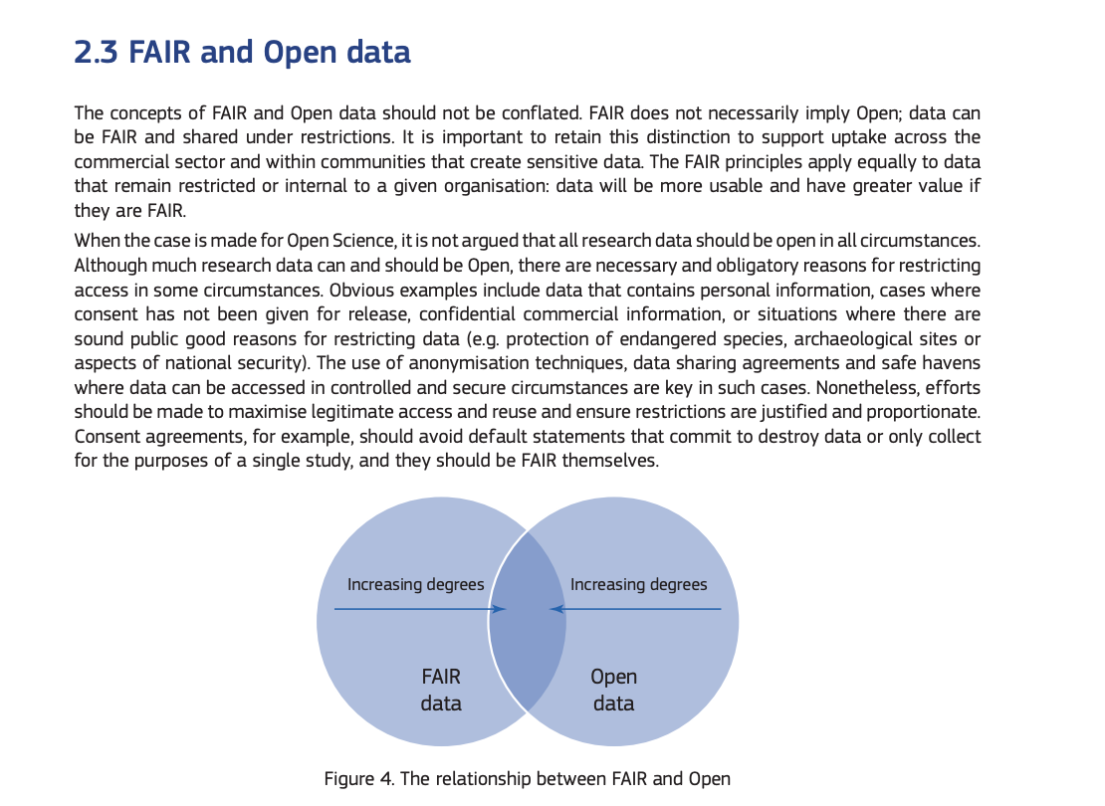
FAIR and Open Data
Source: https://ec.europa.eu/info/sites/info/files/turning_fair_into_reality_0.pdf

Slide 39
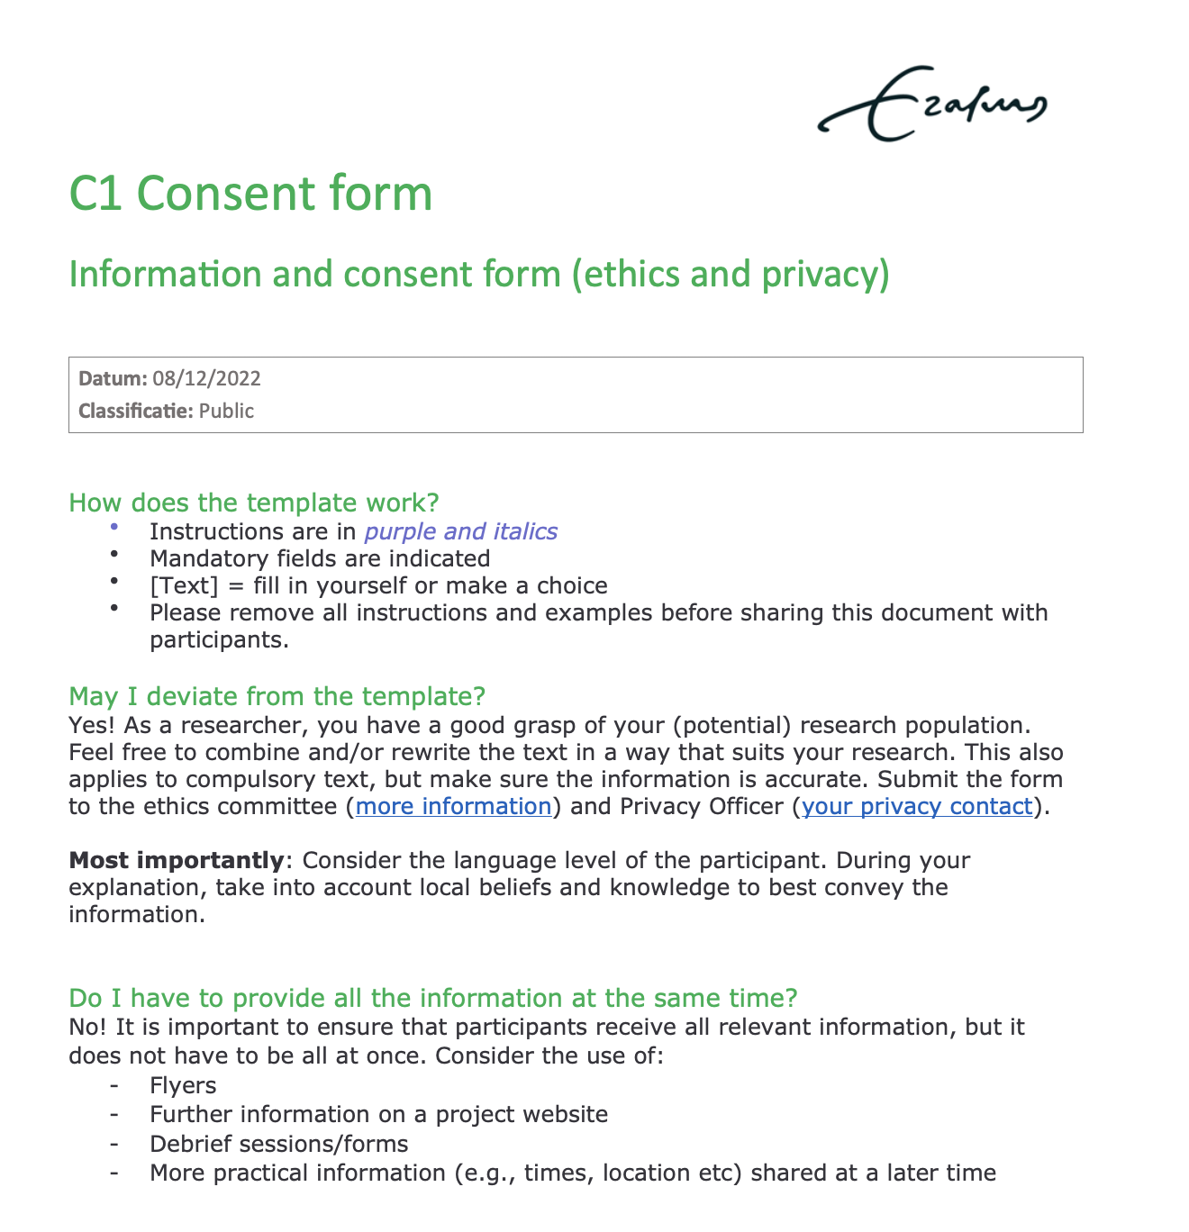
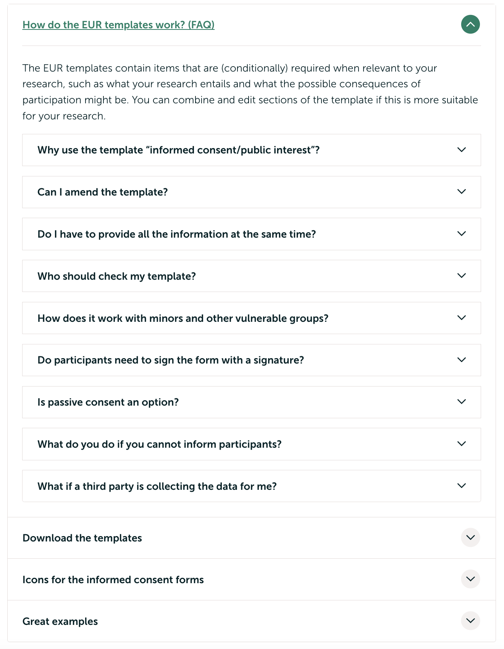
Transparency and Consent Forms
May 30 2023

Slide 40
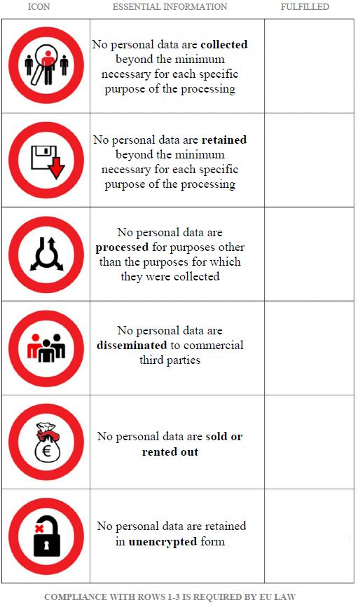
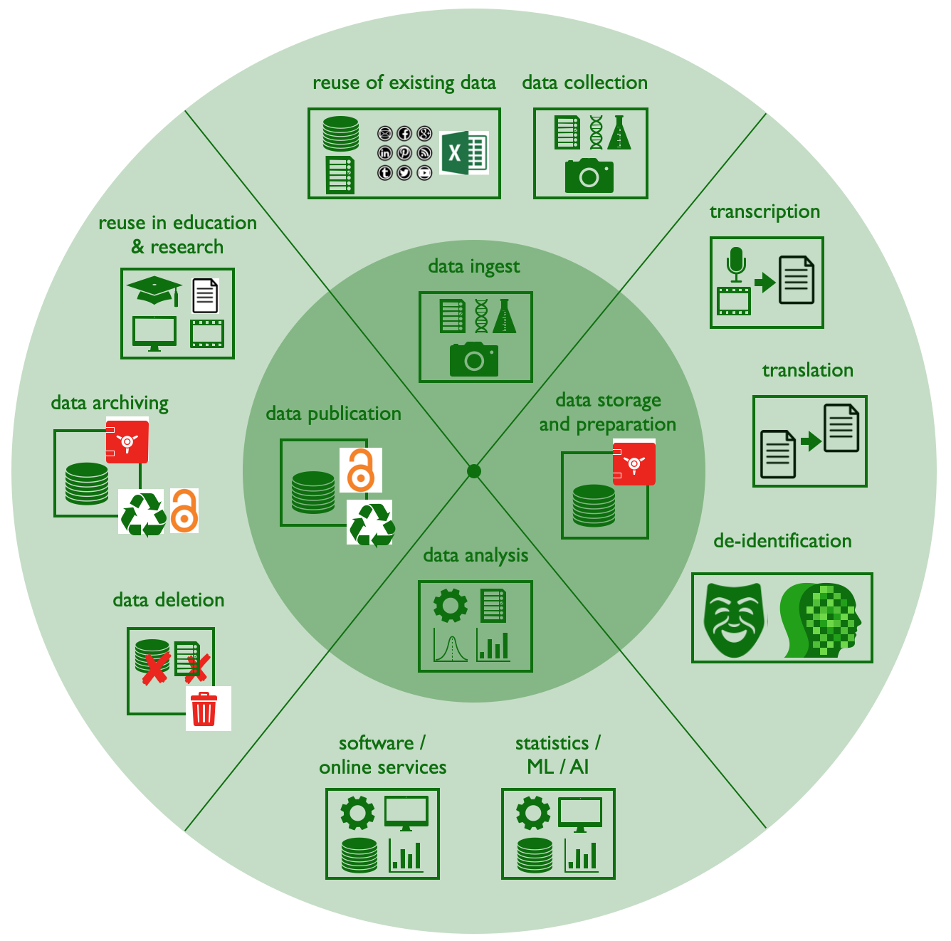
Helicopter View: Benefits of
Risk Assessment in Research Projects
2.b. … communicate in your consent form
and in your privacy statement
on your research project website
0. Research Project
with characteristics
related to, amongst others,
collaboration
and nature of the data.
2.a. … implement prior to and during the project.
2. Identify Risk Mitigating Measures
(organisational & technical)
and document these
in your data management plan, and …
1. Identify Risks
during the research design phase
related to the
research characteristics
Risk icon: https://pixabay.com/vectors/danger-warning-signs-triangle-34250/
GDPR icon: https://pixabay.com/nl/illustrations/gdpr-gdpr-pictogram-privacy-3374574/
Bright Green Checkbox icon: https://commons.wikimedia.org/wiki/File:Bright_green_checkbox-checked.svg Settings icon: https://www.iconsdb.com/green-icons/settings-25-icon.html
Consent Form icon: https://www.cleanpng.com/png-informed-consent-computer-icons-implied-consent-cl-1788346/download-png.html
Privacy Icons: Alexander Alvaro [2012], LIFECYCLE DATA PROTECTION MANAGEMENT.
A contribution on how to adjust European data protection to the needs of the 21st century.
Marlon Domingus, EUR, marlon.domingus@eur.nl
Sybren Spoelstra, Considerati, spoelstra@considerati.com
July 2020

Slide 41
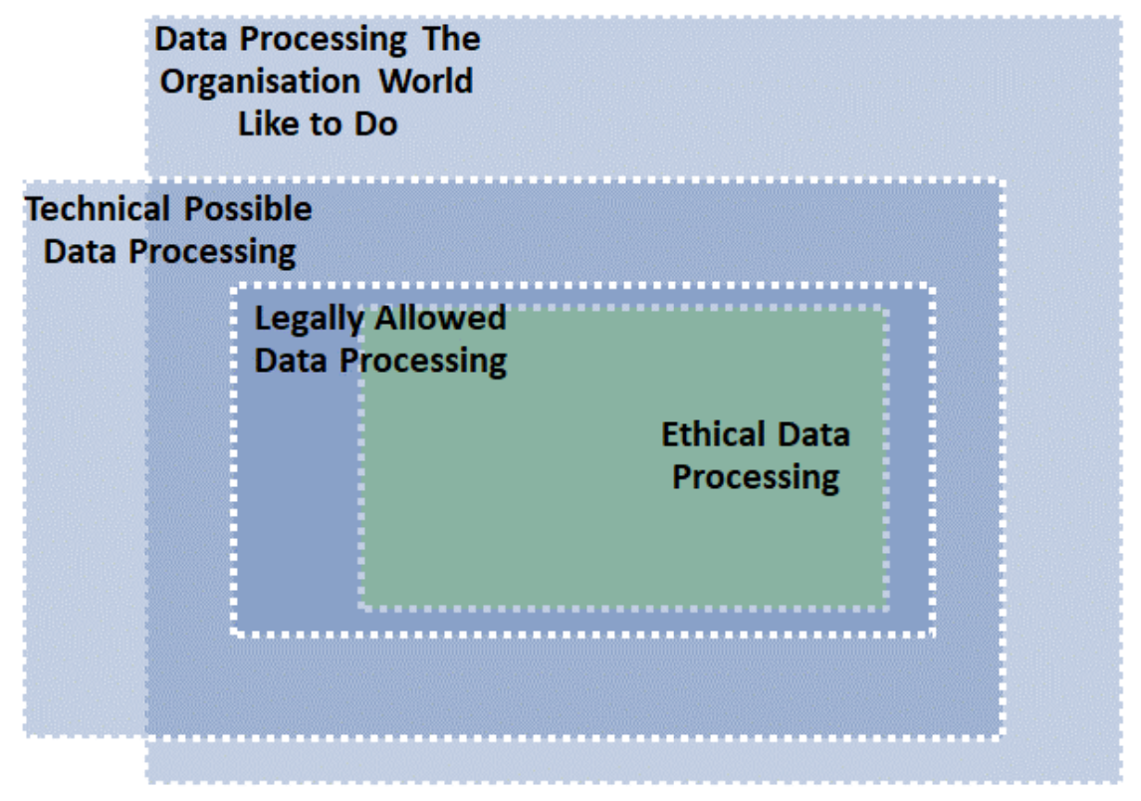
Privacy and Ethics
Source: McSweeney, Alan. (2019). GDPR -Context, Principles, Implementation, Operation, Data Governance, Data Ethics and Impact on Outsourcing. Warwick Legal Network Conference.
Online: https://www.researchgate.net/publication/333602737_GDPR_-Context_Principles_Implementation_Operation_Data_Governance_Data_Ethics_and_Impact_on_Outsourcing_Warwick_Legal_Network_Conference

Slide 42
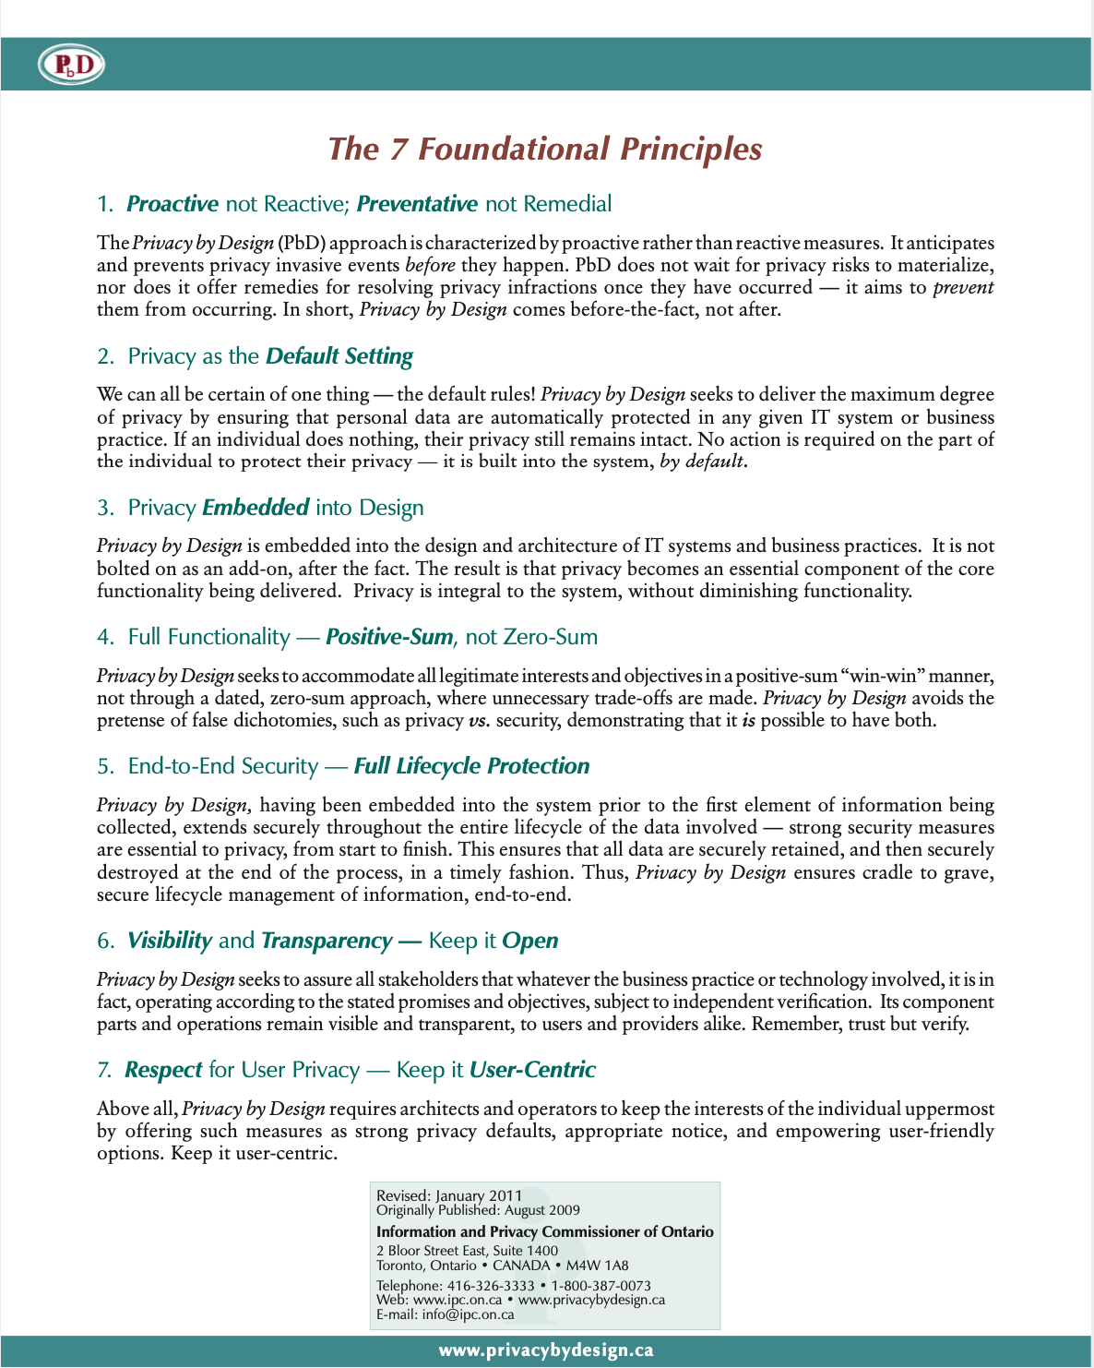
Privacy By Design
May 30 2023

Slide 43
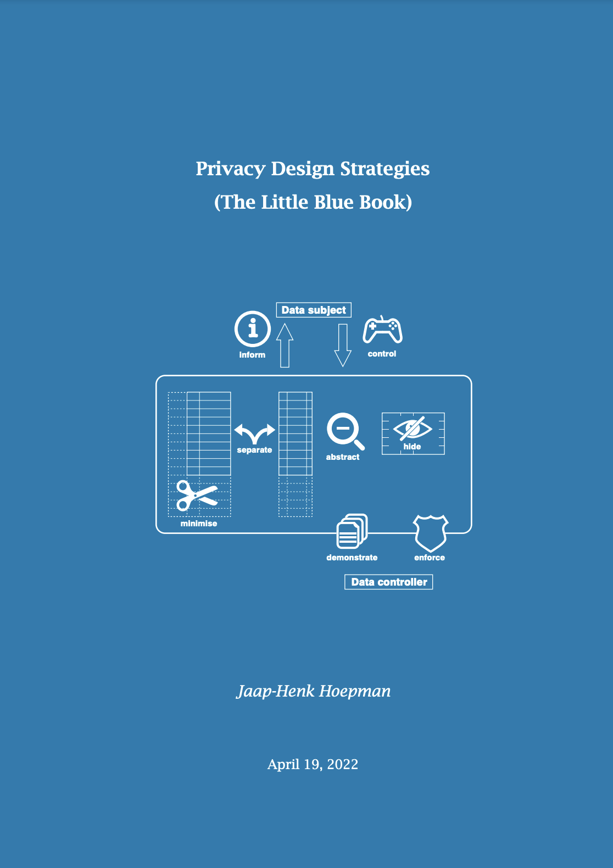
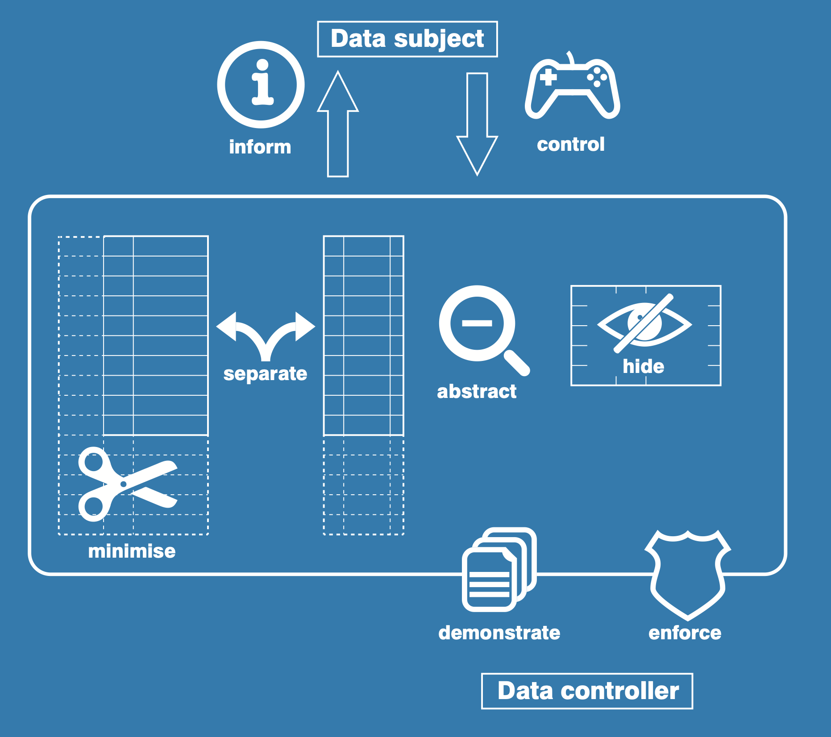
Privacy By Design
May 30 2023

Slide 44
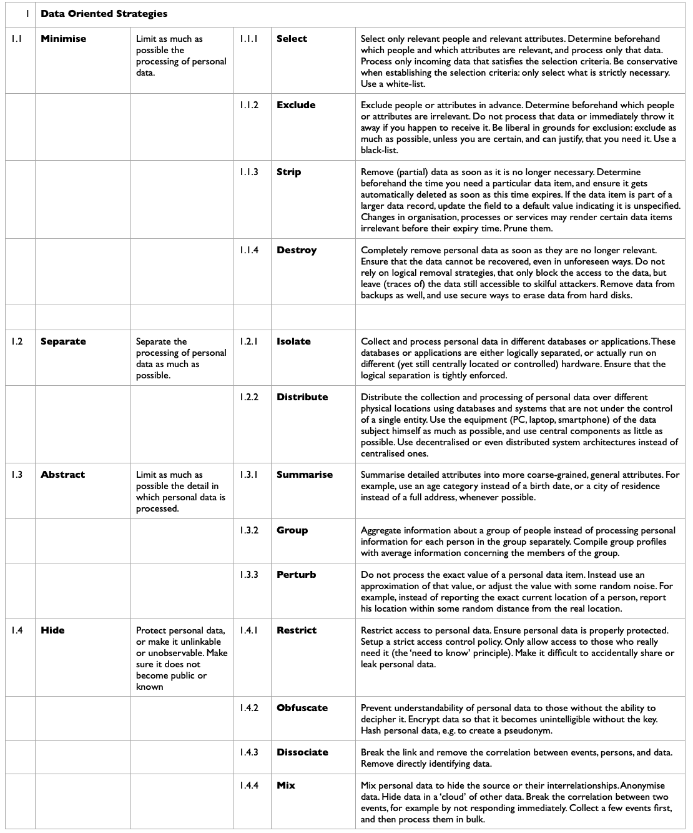
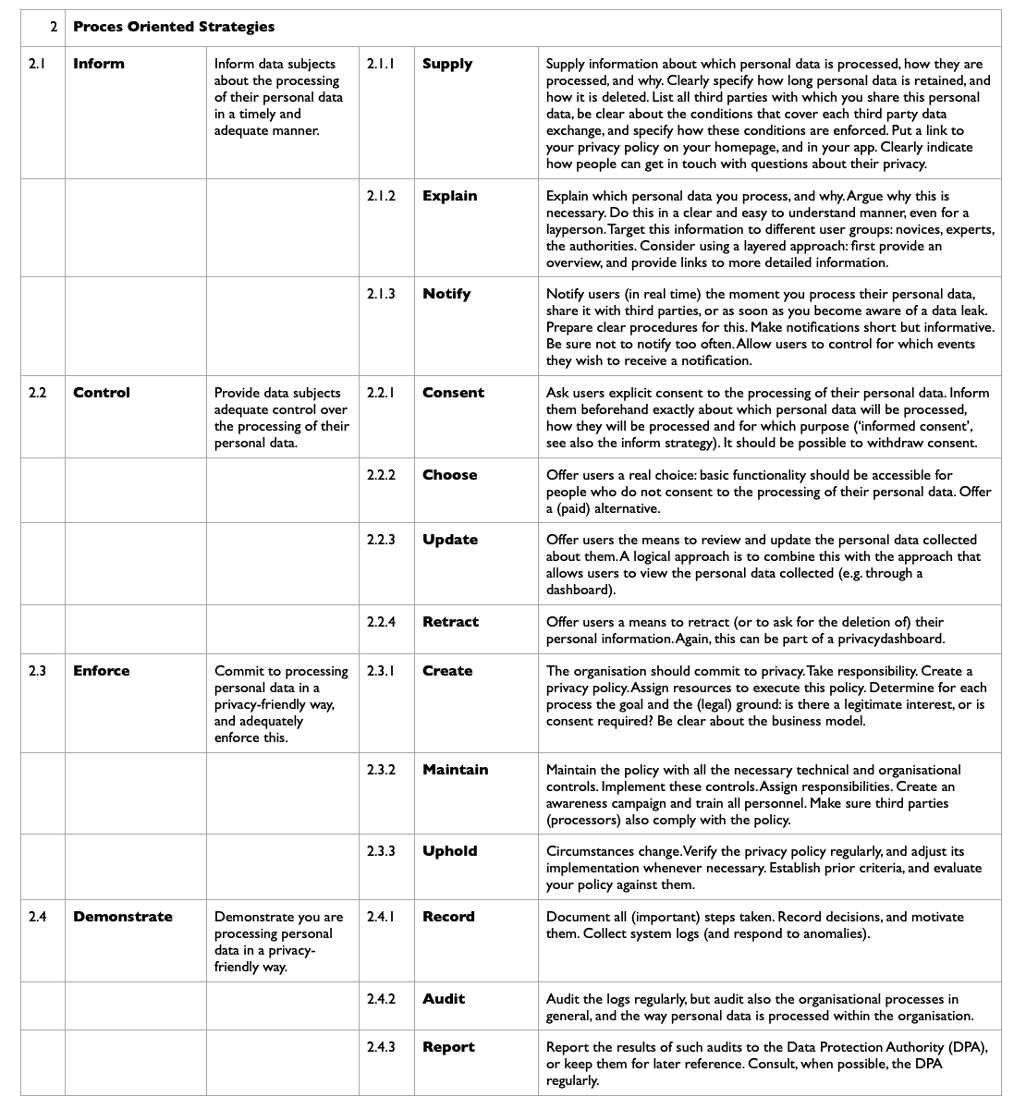
May 30 2023

Slide 45
Privacy in Academic Research;
A Convenient Overview For Your Privacy By Design Approach
General questions: purpose of data collection / which data necessary, given the purpose / is the processing allowed / we could, but should we?
Specific risks to assess for collection and application of personal data - collect evidence that substantiates answers to the questions below.
Risk Assessment:
1. of the individuals (data subjects): are the individuals minors and / or member of a vulnerable group? Have the individuals not given their implicit consent? Are the individuals consulted prior to the collection of their personal data and do the individuals understand possible risks
related to the processing of their personal data now and in the future (further processing)?
2. of the responsible person (controller) of the processing of personal data: is the person / organisation trustworthy, what is the track record
in terms of data breaches (appropriate safeguards) and in terms of transparency? Which (ISO) standards are in place, which external audit(s)
provide evidence for application of appropriate safeguards?
3. of the personal data: is the data quality and integrity optimal? Is the data trusted, secure and protected (encrypted, pseudonymised).
Is the data sensitive (special categories of personal data)? What is the scope of the data: large scale / case study / longitudinal dataset?
Is the dataset likely to be hacked, what are re-identification risks, for instance as a result of further processing and data linkage?
4. of the processing of personal data: is access to the data on a need to know base, is the access controlled (logged) and monitored?
Is the scale of the processing large (> 10.000 individuals)? Is the processing done manually / automatically? Does the processing entail systematic
monitoring of individuals?
5. of the technologies used when processing personal data: are privacy-invasive methods or technologies used, such as camera systems
to monitor behaviour? Is sensitive information recorded? Is personal data mined (eg. data mining social media data) or ‘web crawled’?
Is social network analysis, or profiling of individuals and/or groups (particularly behavioural or psychological profiling) performed?
Is artificial intelligence used to analyse personal data using auto mated decision-making that has a significant impact on the data subject(s)?
6. of the third parties collaborating when processing personal data: see (2) above and additionally: which sub contractors are used by the third party?
7. of the geographical aspects (cross border data transfers) when processing personal data: Do you share personal data with a third party outside
the European Union, Norway, Liechtenstein and Iceland? The European Commission may have determined that this non-EU country has an adequate level of data protection, which allows you to share personal data. Otherwise, consult your privacy officer or data steward.
8. of the legal agreement(s) (data processing agreement / joint controller agreement / non disclosure agreement /…) ensuring proper distribution
of responsibilities and accountability for the processing personal data: how soon after relevant changes are partners updated (new sub contractors, processing in other geographical areas)? In general, which concessions have been made?
Personal Data
Collection
Direct and indirect collection of
(special categories of) personal data
Personal Data
Application
Including reuse (further processing)
of personal data
Societal Effect of
use of Personal Data
Reasonably Expected
Creepy
Violating Privacy Rights
of Individuals and/or Groups
Marlon Domingus
Erasmus University Rotterdam
marlon.domingus@eur.nl
Augustus 2019
- Gender Neutral Icon by Dan Brunsdon: https://thenounproject.com/term/gender-neutral/13777/
Updated August 5 2019
- European Commission, H2020 Grants Manual, Ethics and data protection. November 14 2018.
Online: https://ec.europa.eu/research/participants/data/ref/h2020/grants_manual/hi/ethics/h2020_hi_ethics-data-protection_en.pdf
- Credits: based on conversations with many people, but notably with Cristina Montagner, Tiemen Folkers, both University of Groningen,
Marina Noordegraaf (https://www.verbeeldingskr8.nl/) and Khaled El Emam and Luk Arbuckle, both from Privacy Analytics (https://privacy-analytics.com/).

Slide 46
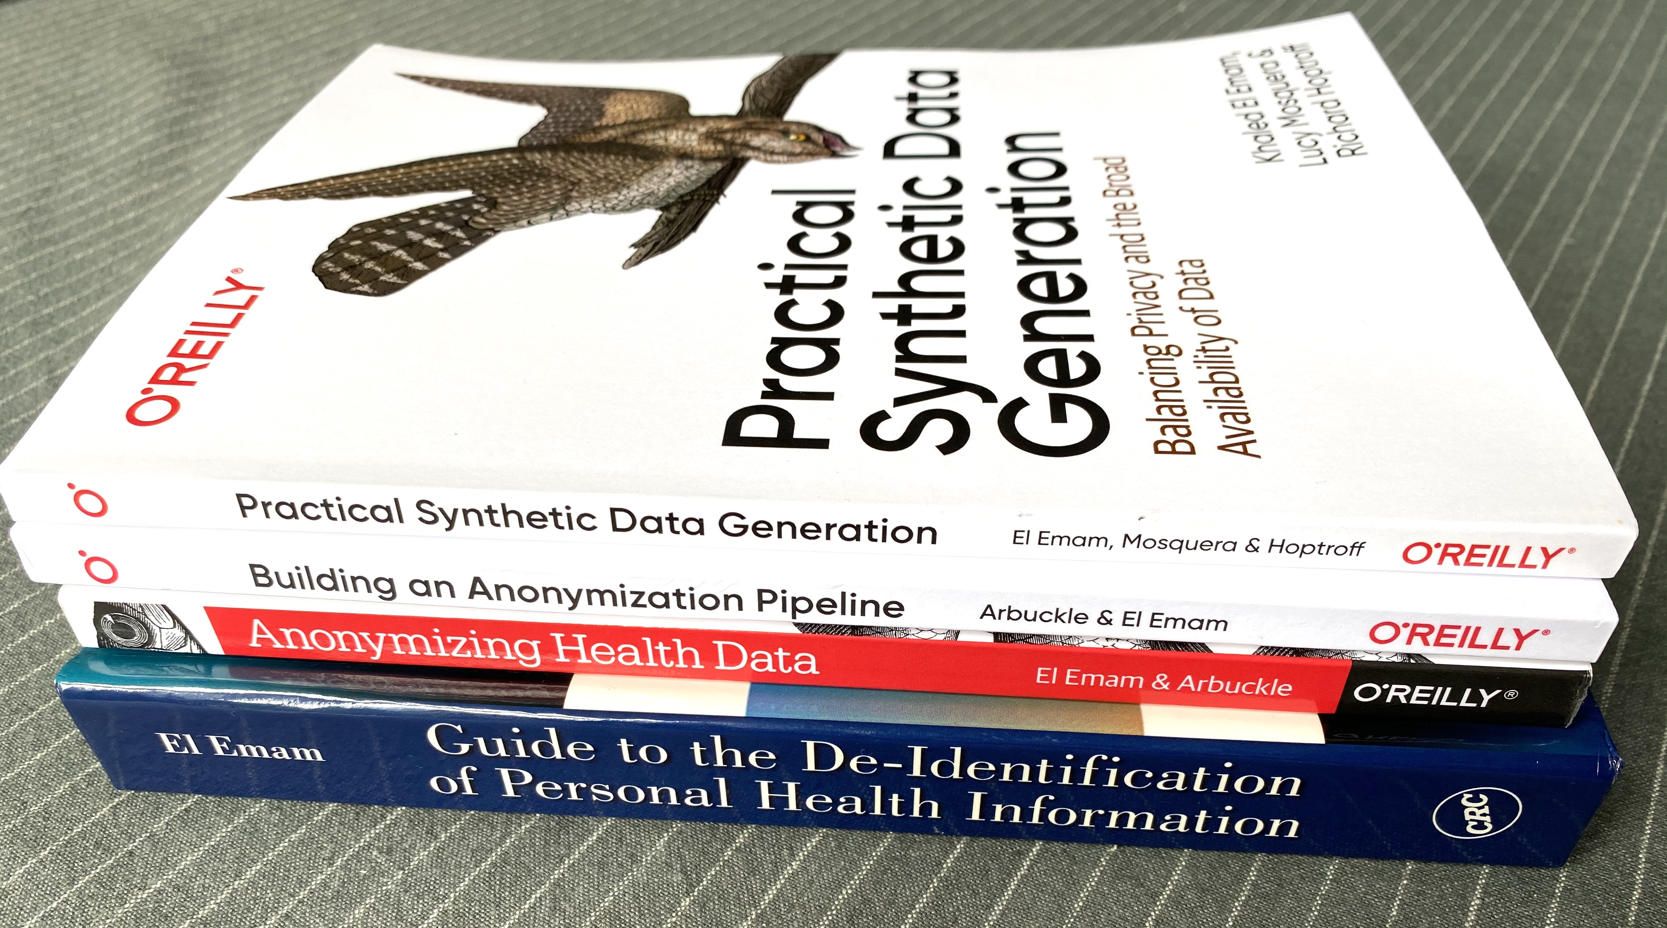
Synthetic Data
May 30 2023

Slide 47
Replica Analytics, What is Synthetic data
Online: https://www.replica-analytics.com/web/default/files/public/tutorials/what-is-synthetic-data-2/presentation_html5.html

Slide 48
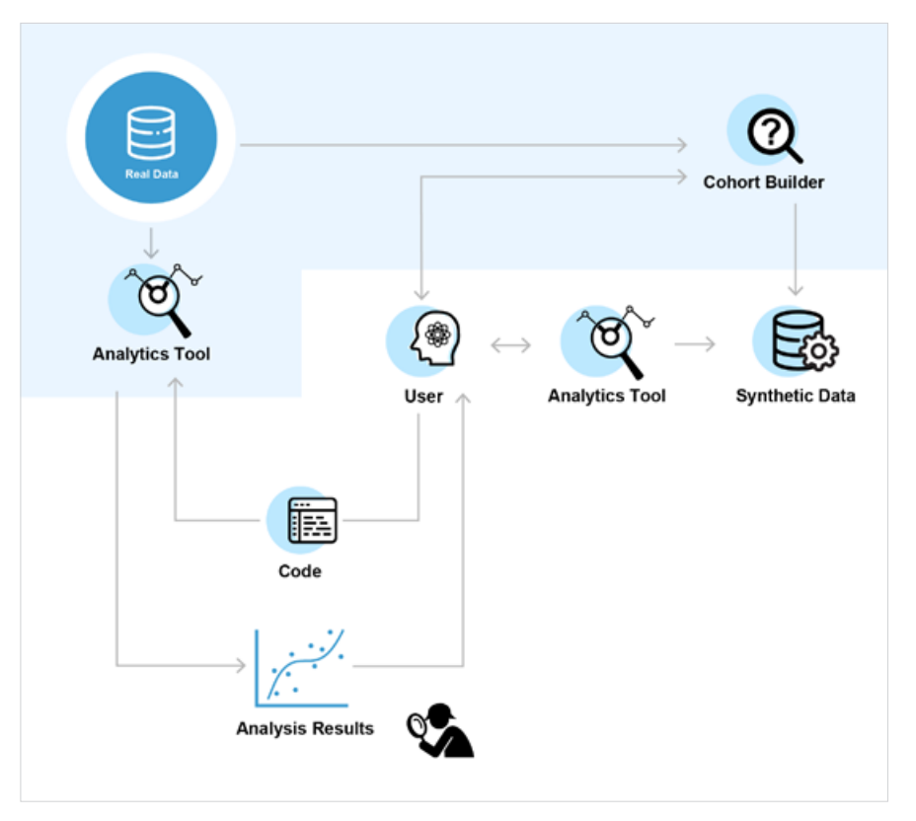
Replica Analytics, What is Synthetic data
Online: https://www.replica-analytics.com/web/default/files/public/tutorials/what-is-synthetic-data-2/presentation_html5.html

Slide 49
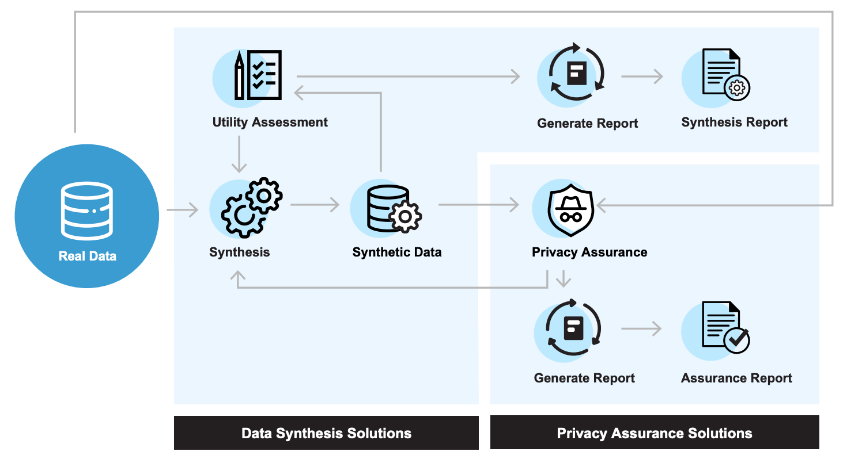
Replica Analytics, What is Synthetic data
Online: https://www.replica-analytics.com/web/default/files/public/tutorials/what-is-synthetic-data-2/presentation_html5.html

Slide 50
additional slides

Slide 51
Privacy in Context - Processings of Personal Data
in a Classic Context and Today’s Context
and Implications for Accountability, Legislation, Ethics and Trust
Classic Context
Today’s Context
Processings within one organization |  | Processings beyond organization in temporary or structural collaboration
Processings executed by users using software (regression / classification: supervised learning) |  | Processings executed by algorithms (unsupervised learning / reinforcement learning)
Processing on site, in one country |  | Processing in the cloud, cross borders
Processings done by own staff; known people, under contract |  | Processings done in collaborations with trusted and new (not yet trusted) partners, collaborators and service providers
Processings done on datasets |  | Processings done on datalakes
EU GDPR fit for purpose?
EU GDPR fit for purpose? AI Legislation?
‘CJEU Schrems II ruling’
EU Digital Services Act
EU GDPR fit for purpose?
Inspired by work done by:
Helen Nissenbaum [Privacy in Context],
Bojana Bellamy et al (CIPL) [CIPL Response to EU Consultation on AI White Paper]
Marie-José Bonthuis [Privacy in Chain Communication Systems]
Erasmus University Rotterdam
marlon.domingus@eur.nl
September 2020

Slide 52
Typical Barriers in Research Collaboration
Research funding requires new forms of collaboration (public / private partners, from countries never before worked with) resulting in different attitudes (implicit and explicit) on collaboration, legal frameworks / jurisdiction, risk appetite, and, for instance, research integrity aspects, which results in ending the research project ahead of time. Code: A [collaboration without a clear and defined common ground]
Parties in a consortium fail to meet the agreed tasks, such as deliver specific datasets, expertise, or tooling and instruments for analysis purposes, sometimes due to lack of appropriate budget and or relevant (technical) expertise, resulting in delays of deliverables and possible ending the research project ahead of time. Code: B [lack of expertise/funding to comply to agreed deliverables and/or compliancy]
Parties in a consortium fail to agree prior to the start of the project in detailed agreements on IPR, data management, privacy and security, often because of prolonged discussions by research support staff from the and do not have the required legal documents in place, nor the required actions and action holders, resulting in inefficiency and potential non compliancy. Code: C [collaboration without a clear and defined policy and governance]
Parties in a consortium fail to provide transparency about the way of working and, for instance data protection, and research findings, which results in research participant’s and data provider’s trust issues. Code: D [collaboration without transparency to data providers and participants]
The consortium is not able to find, or does not actively seek available relevant datasets for their research project, due to bad disclosure of datasets (not ‘FAIR’ and/or not registered in any trusted research data archive). Or: the consortium knows about existing relevant datasets but decides to start generating new data because of the bureaucratic burden of accessing the existing data. Or the consortium has access - via peers - to relevant datasets, but they are, due to data disparity (inconsistent data / differing data terminology/ etc ) de facto not re-useable for the research project. Or the data (say: ‘patient data’) is legally not available for re-use for research purposes, because the researcher has no treatment relation with the patent. Or because the (industry) partner within the consortium should not have access to the data, for instance for commercial exploitation, because of ethical and legal considerations. All scenarios result in potential unnecessary delays whilst collecting data that already exists, and what is sometimes called ‘the waste of science’. Code E [no re-use of data sought, or re-use not practically, legally or ethically possible]
The consortium has no one clear policy, practical knowledge, suitable tooling, templates with regards to data protection, in terms of risk assessment, privacy by design, data governance, de-identification, access management, assessing the ‘need to know’ of consortium members, and lacks sufficient and timely support and funding for these responsibilities. Risk assessment of re-use of existing tooling/algorithms and risk assessment of service providers/sub providers is typically not a standard procedure in existing processes. Resulting in potential non compliancy and data breaches. Code F [lack of knowledge, tooling, support and funding to be compliant to applicable legislation]
The consortium is willing to make research data available for follow on research according to the research funder’s requirement and/or the Open Data / FAIR policies of the consortium members. However, this is time consuming and thus costly; to which level should data be described for which purposes and how to establish if research data can put really publicly online or, alternatively in a trusted data archive for follow on research by researchers exclusively? Lack of discipline specific guidelines in combination with due investment in time and money results possibly in not making data available for follow on research or sharing too much data publicly, potentially resulting in re-identification risks and thus a data breach. Code G [not making data available for follow on research (often a research funder’s requirement) due to lack of discipline specific guidelines]
The consortium prefers not to make their valuable datasets findable simply of fear that they would be burdened with large number of requests for the datasets (fear that it would be time-consuming to evaluate and process all the requests). Code H [not making data available for follow on research (often a research funder’s requirement) due to lack of an available accepted research incentive for the researcher]
The consortium is not sure which data to retain, for how long, and where. All raw data? Only analysed data? Pseudonymised analysed data? The codebook? The lab journals? Also the algorithms? The documentation of the code? The training sets? The intended audiences for the data after the research project, legally based on archived consent, suitable for the further re-use? Uncertainty in combination with investment in time and money results possibly in not making data available for follow on research or sharing too much data publicly, potentially resulting in re-identification risks and thus a data breach. Code I [not adequately retaining research data (as required by research integrity standards) due to lack of discipline specific guidelines]
Marlon Domingus, January 14, 2021. Contributions by: Evert Stamhuis, Robert Veen, Jan-Jaap Visser, Marta Teperek, and Isabel van der Heiden.

Slide 53
Typical Barriers in Research Collaboration
individual research
access existing data
research funding
- 1e geldstroom
- 2e geldstroom - 3e geldstroom
research proposal
- public
- private - public / private
research project
- nationaal - internationaal
store data
analyse data
publish article and data
archive article and data
research group
generate data
Barriers
Policy |  | A, C, D, F, G, H, I |  | A, E | A, B | A, B, D | A, D | A, D, G, H, I
Infra & Tooling |  | C |  | D, E, F | F | D, F | C, F | C, D, F, H, I
Legal & Ethical |  | C, F, G |  | D, E, F, G, H, I | F | D, F | F | F, G, H, I
Support |  | C, G |  | E, F | F | D, F | D | D, F, H, I
Marlon Domingus, May 2017

Slide 54
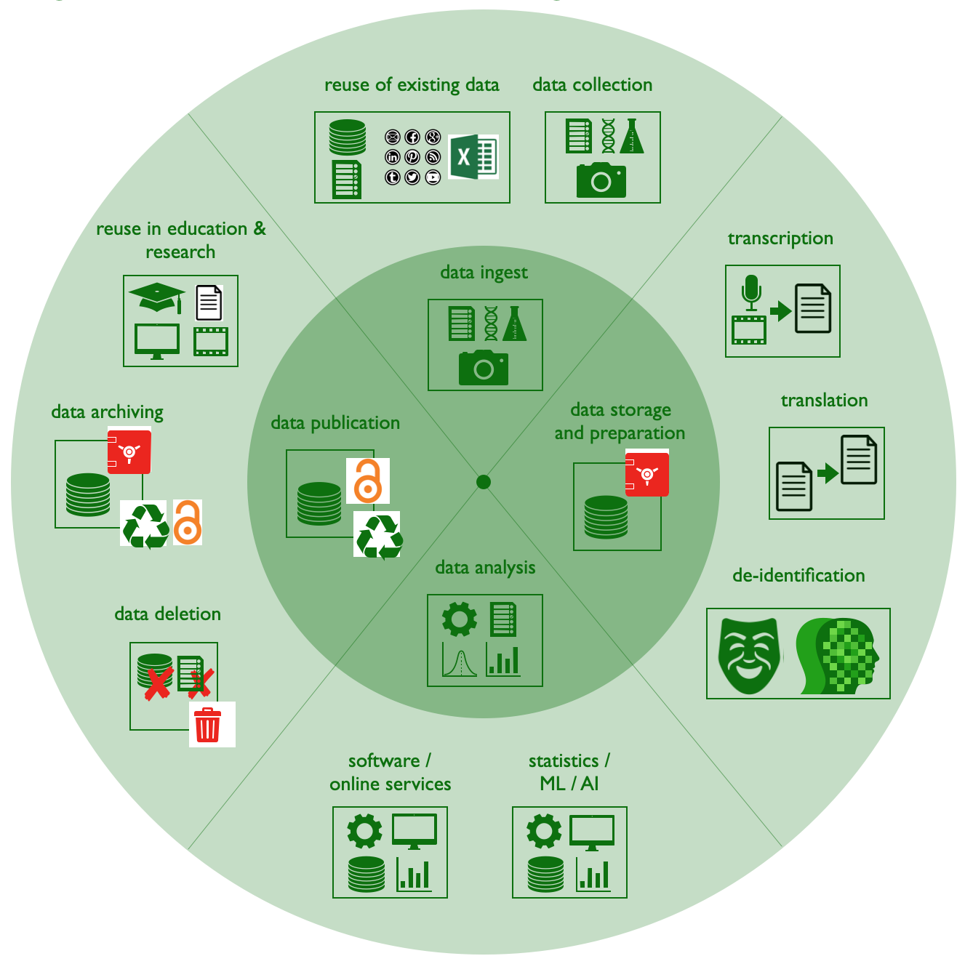
Data Protection:
Rights and Obligations
“on the protection of natural persons
with regard to the processing
of personal data
and on the free movement of such data”
GDPR
Research Participant
Rights
UAVG
Obligations
Researcher
The research participant’s rights
Information and access to personal data
- Information to be provided where personal data are collected from the data subject
- Information to be provided where personal data have not been obtained from the data subject
- Right of access by the data subject
Rectification and erasure
- Right to rectification
- Right to erasure ('right to be forgotten')
- Right to restriction of processing
- Notification obligation regarding rectification or erasure of personal data or restriction of processing
- Right to data portability
Right to object and automated individual decision-making
- Right to object
- Automated individual decision-making, including profiling
The researcher’s obligations
- Data protection by design and by default
- Data protection impact assessment and prior consultation - Demonstrate compliancy with the principles relating to processing of personal data
- Records of processing activities
- Security of personal data
- Security of processing
- Communication of a personal data breach to the data subject
- Notification of a personal data breach to the supervisory authority
Inspired by: Cortina S., Valoggia P., Barafort B., Renault A. (2019) Designing a Data Protection Process Assessment Model Based on the GDPR. In: Walker A., O'Connor R., Messnarz R. (eds) Systems, Software and Services Process Improvement. EuroSPI 2019. Communications in Computer and Information Science, vol 1060. Springer, Cham. https://doi.org/10.1007/978-3-030-28005-5_11
Marlon Domingus, Erasmus University Rotterdam
marlon.domingus@eur.nl December 2020

Slide 55
JOIN OUR COMMUNITY

